Slide 1



Hospital Readmissions Use Case
Faizan Khalid Mohsin
M.Sc. Biostatistics & AI Applications
University of Toronto
Demo
LinkedIn: https://www.linkedin.com/in/faizan-khalid-mohsin/
GitHub: https://github.com/FaizanKhalidMohsin

Slide 2

Agenda
DataRobot Company Overview.
What does DataRobot do?
The Hospital Readmissions Use Case Problem Intro.
The Hospital Readmissions DataRobot Demo.
Summary
Q&A

Slide 3
DataRobot Company Overview

Slide 4
DataRobot Company Overview
Enterprise AI

Slide 5
DataRobot Company Overview
Enterprise AI
Founded in 2012

Slide 6
DataRobot Company Overview
Enterprise AI
Founded in 2012
Cloud Platform

Slide 7
DataRobot Company Overview
Enterprise AI
Founded in 2012
Cloud Platform
Over 1,000 employees (200+ Data Scientist)

Slide 8
DataRobot Company Overview
Enterprise AI
Founded in 2012
Cloud Platform
Over 1,000 employees (200+ Data Scientist)
Helped over 3,000 Companies¹

Slide 9
DataRobot Company Overview
Enterprise AI
Founded in 2012
Cloud Platform
Over 1,000 employees (200+ Data Scientist)
Helped over 3,000 Companies¹
Built over 2.5 billion machine-learning models¹

Slide 10
DataRobot Company Overview
Enterprise AI
Founded in 2012
Cloud Platform
Over 1,000 employees (200+ Data Scientist)
Helped over 3,000 Companies¹
Built over 2.5 billion machine-learning models¹
Over $100 million in annual revenue^{2,3}

Slide 11
DataRobot Company Overview
Enterprise AI
Founded in 2012
Cloud Platform
Over 1,000 employees (200+ Data Scientist)
Helped over 3,000 Companies¹
Built over 2.5 billion machine-learning models¹
Over $100 million in annual revenue^{2,3}
Raised $1 Billion in Funding to date⁴

Slide 12
DataRobot Company Overview
Enterprise AI
Founded in 2012
Cloud Platform
Over 1,000 employees (200+ Data Scientist)
Helped over 3,000 Companies¹
Built over 2.5 billion machine-learning models¹
Over $100 million in annual revenue^{2,3}
Raised $1 Billion in Funding to date⁴
Current Company Valuation: $6 Billion⁵

Slide 13
DataRobot Company Overview
Enterprise AI
Founded in 2012
Cloud Platform
Over 1,000 employees (200+ Data Scientist)
Helped over 3,000 Companies¹
Built over 2.5 billion machine-learning models¹
Over $100 million in annual revenue^{2,3}
Raised $1 Billion in Funding to date⁴
Current Company Valuation: $6 Billion⁵
$10+ Billion ROI delivered to customers⁶

Slide 14
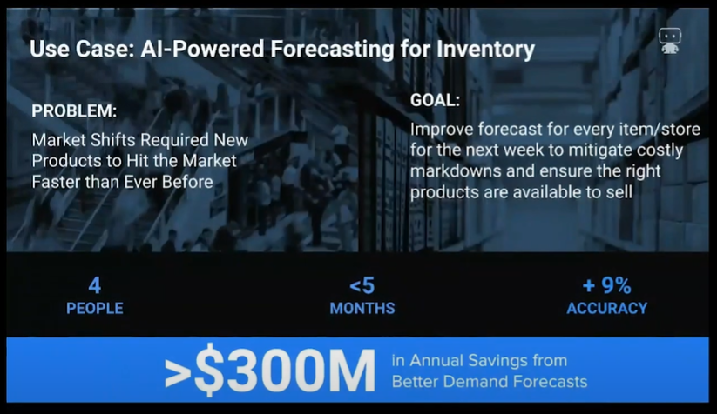
DataRobot Customer Value Use Case
Increased prediction accuracy by 9% ---> $300Million s

Slide 15
DataRobot Customer Value Use Case
Increased prediction accuracy by 9% ---> $300Million s

Slide 16
DataRobot Customer Value Use Case
Increased prediction accuracy by 9% ---> $300Million s

Slide 17






DataRobot Partners

Slide 18
What does DataRobot do?
A Glimpse into the DataRobot Machine Learning Automation Platform
https://www.youtube.com/watch?v=_JOKlSwKJ10&ab_channel=DataRobot
DataRobot Introduction
https://www.youtube.com/watch?v=L3V_UJugtJ0&t=4s&ab_channel=MaxIoli

Slide 19
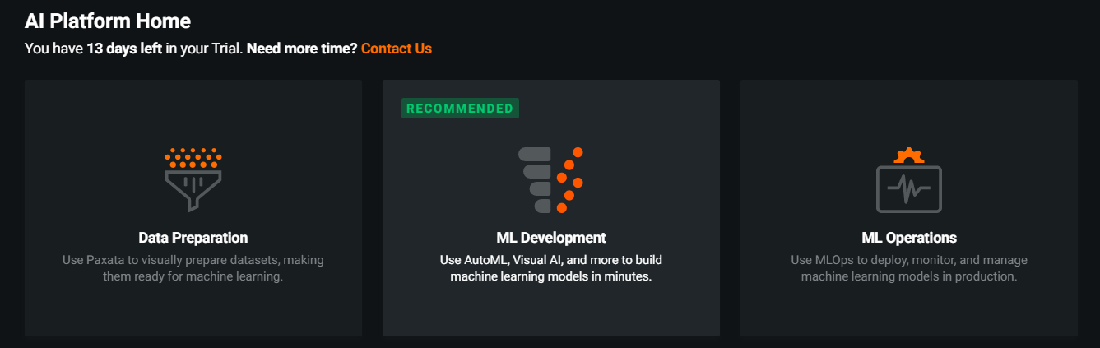
What does DataRobot do?
Fully functional complete end-to-end Data Science pipeline platform:
Data Ingestion + Preparation
Model Building
Model Deployment + Monitoring

Slide 20
What does DataRobot do?
Fully functional complete end-to-end Data Science pipeline platform:
Data Ingestion + Preparation
Model Building – Today’s Demo
Model Deployment + Monitoring – Today’s Demo
Today’s Demo

Slide 21
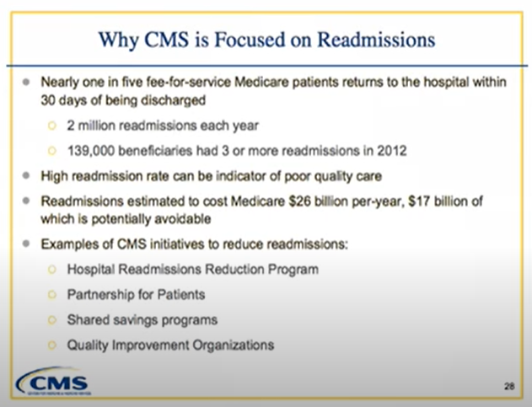

The Hospital Readmission Problem Center for Medicare & Medical Services

Slide 22
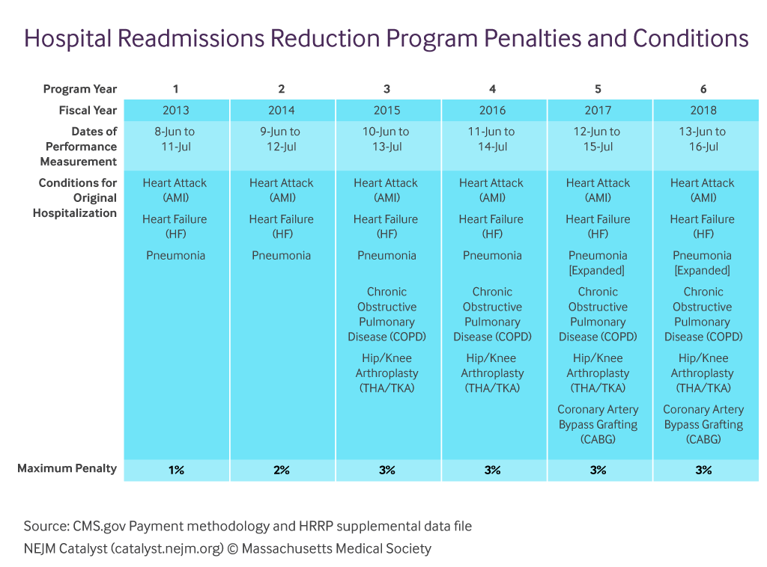
The Hospital Readmission Problem Center for Medicare & Medical Services

Slide 23
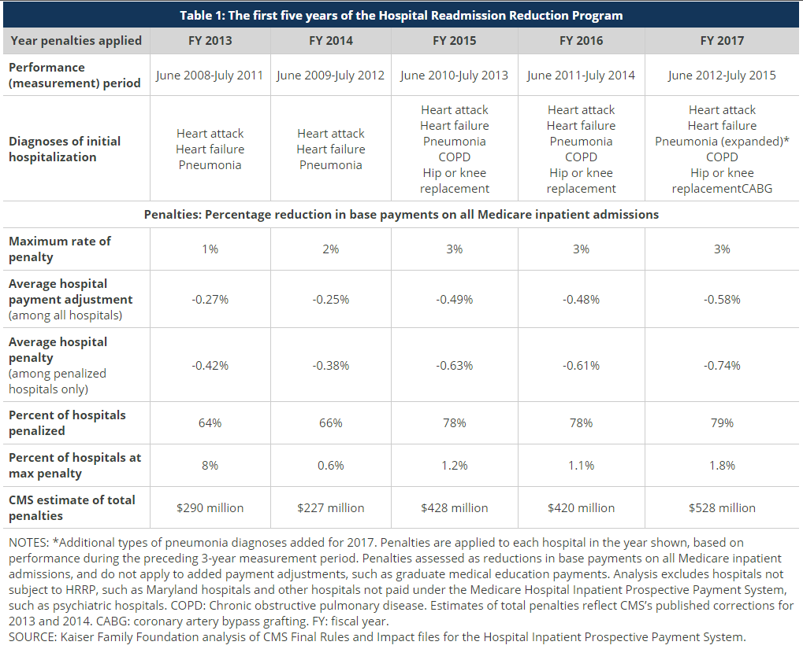
The Hospital Readmission Problem Center for Medicare & Medical Services

Slide 24
Live Demo – Important Links
New Project and Dataset:
https://app2.datarobot.com/new
Cooked Model:
https://app2.datarobot.com/projects/60fc27bf1883e1d80fca33c7/models

Slide 25
Back up Slides in case of connection failure for the Live Demo.

Slide 26
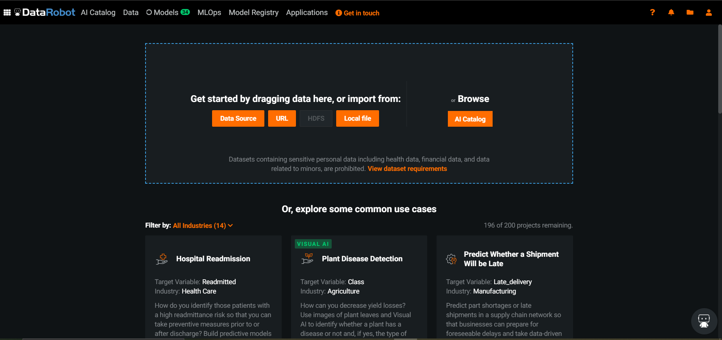
Hospital Readmission – Data Ingestion

Slide 27
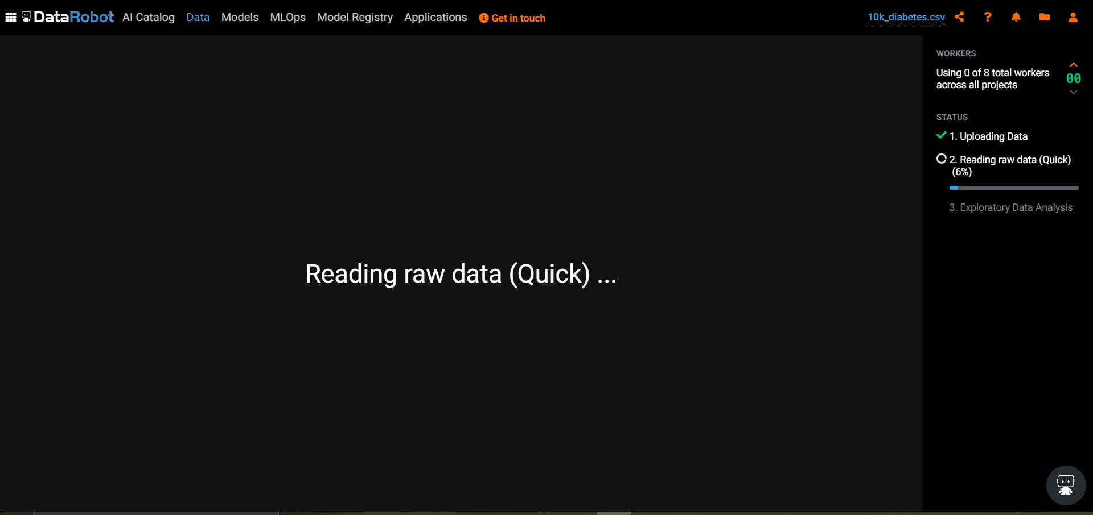
Hospital Readmission – Data Ingestion

Slide 28
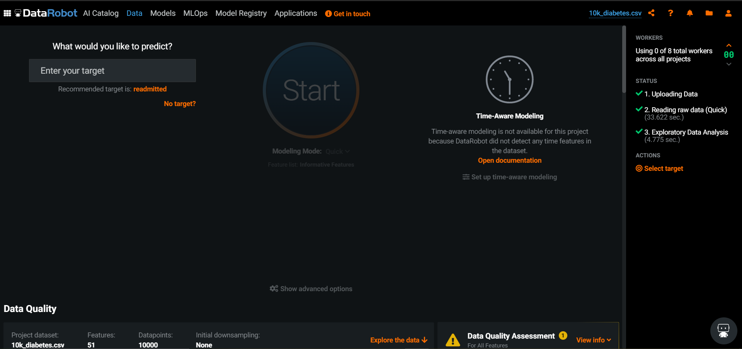
Hospital Readmission – Data Ingestion

Slide 29
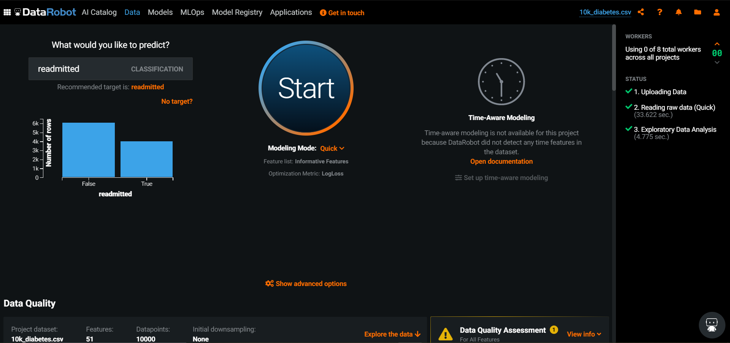
Hospital Readmission – Data Ingestion

Slide 30
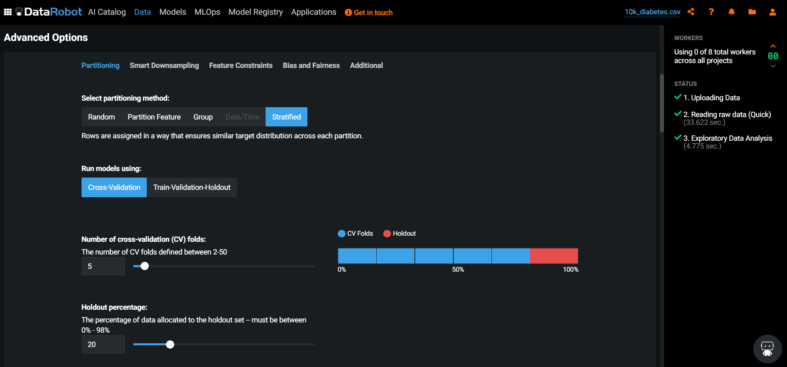
Hospital Readmission – Data Ingestion

Slide 31
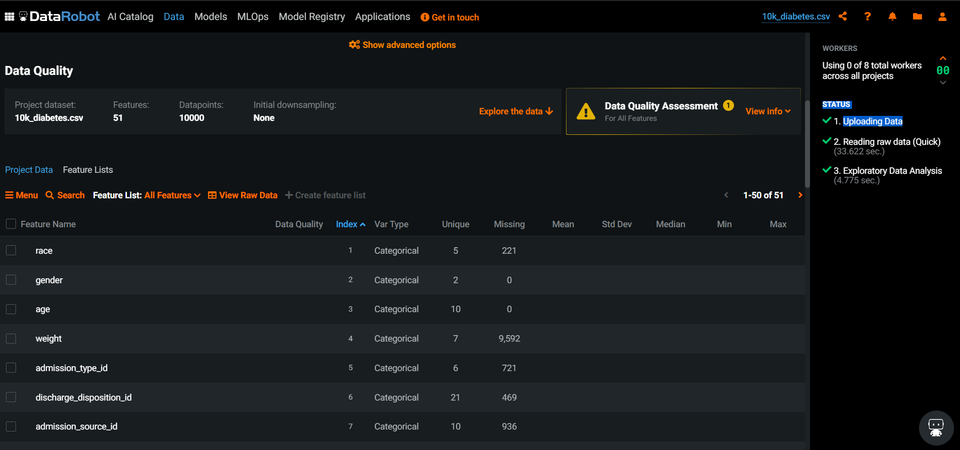
Hospital Readmission – EDA

Slide 32
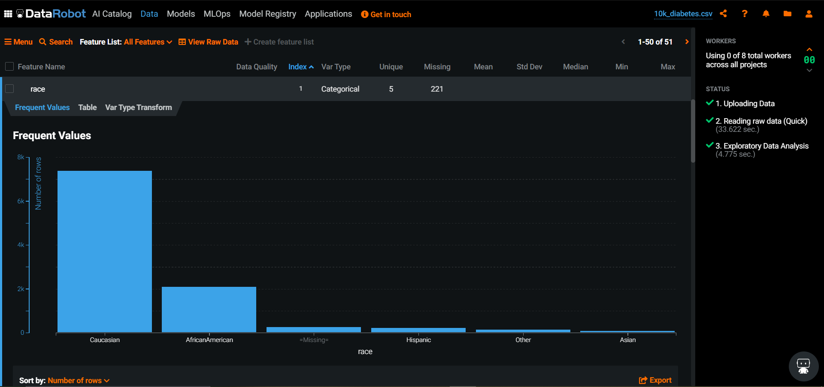
Hospital Readmission – EDA

Slide 33
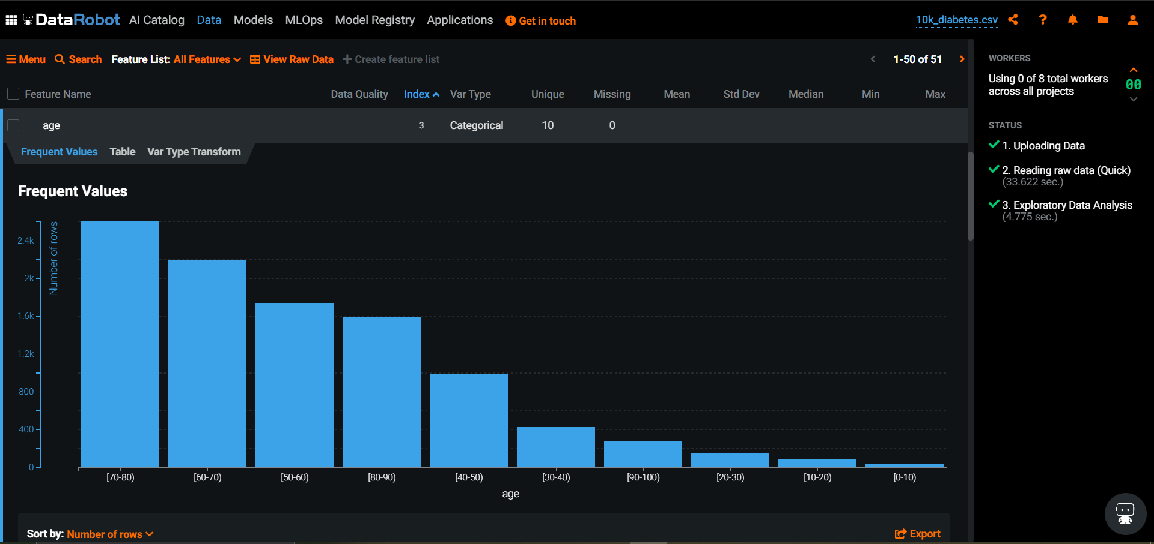
Hospital Readmission – EDA

Slide 34
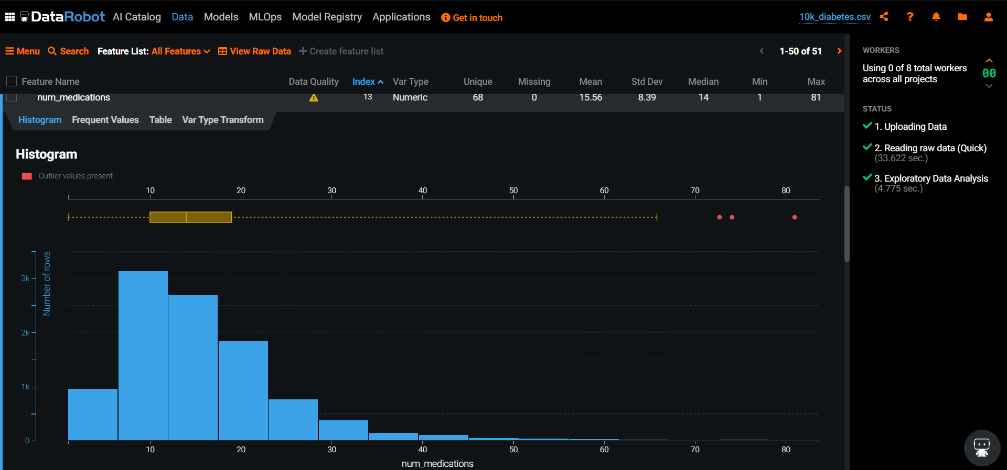
Hospital Readmission – EDA

Slide 35
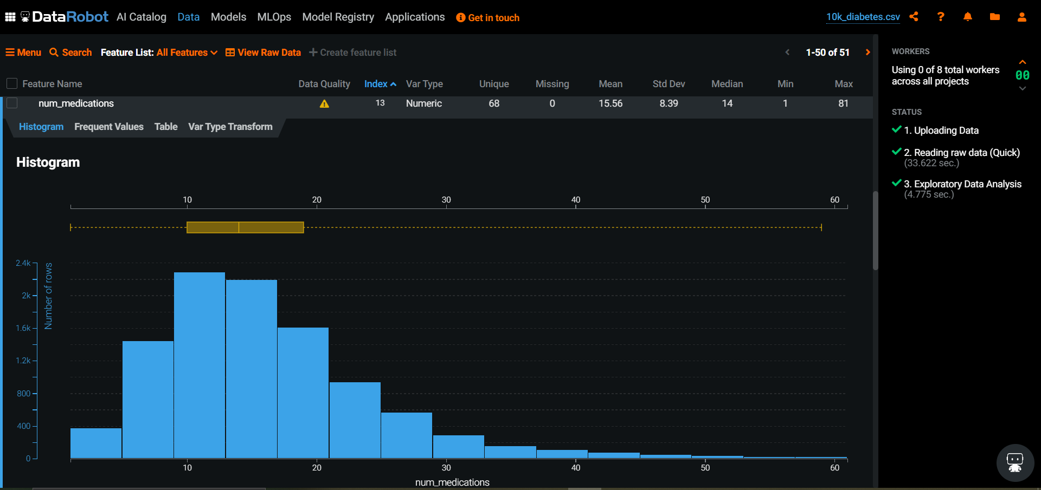
Hospital Readmission – EDA

Slide 36
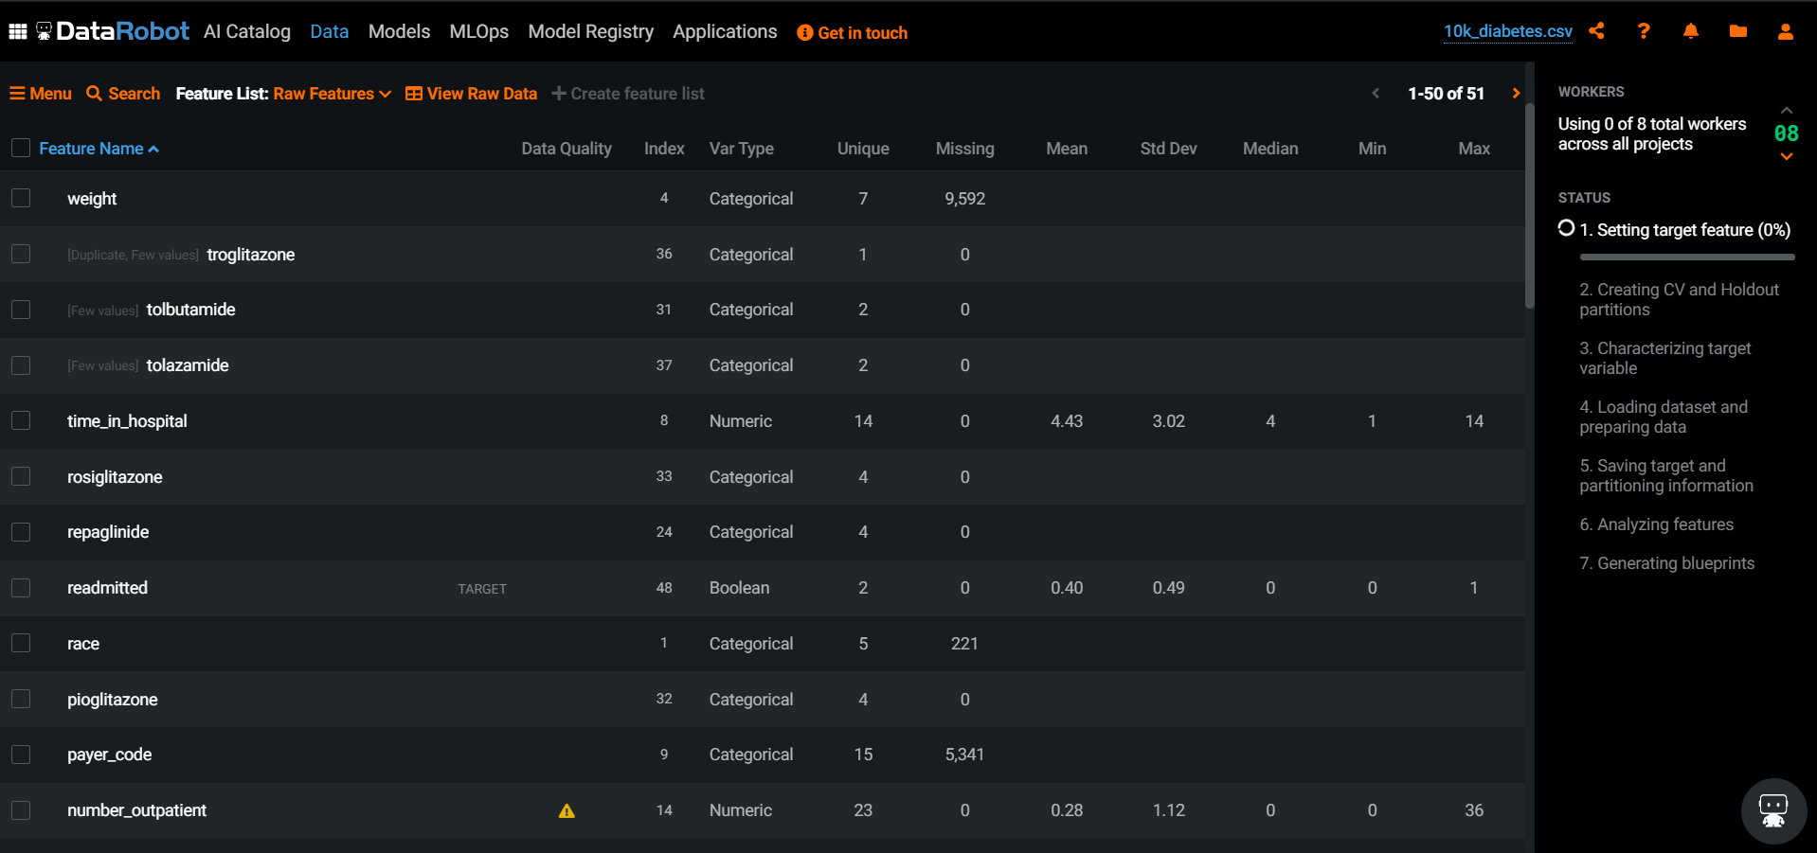
Hospital Readmission – Variable Importance

Slide 37
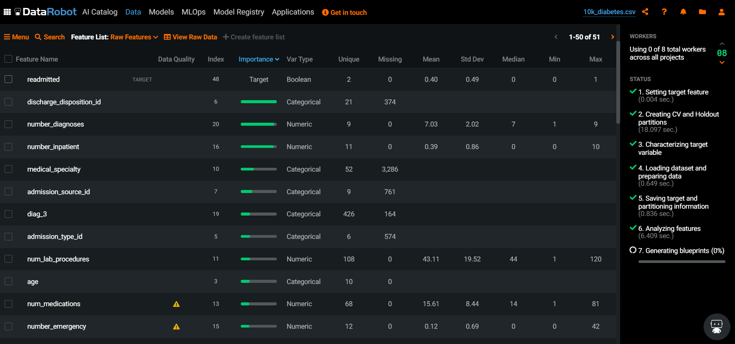
Hospital Readmission – Variable Importance

Slide 38
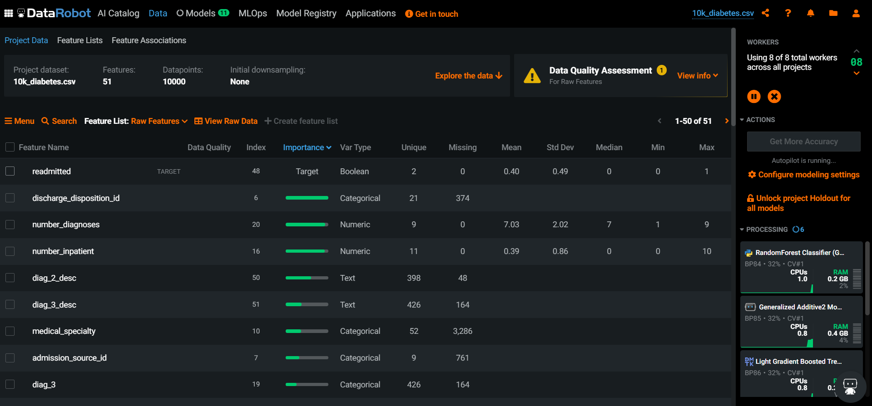
Hospital Readmission – Variable Importance

Slide 39
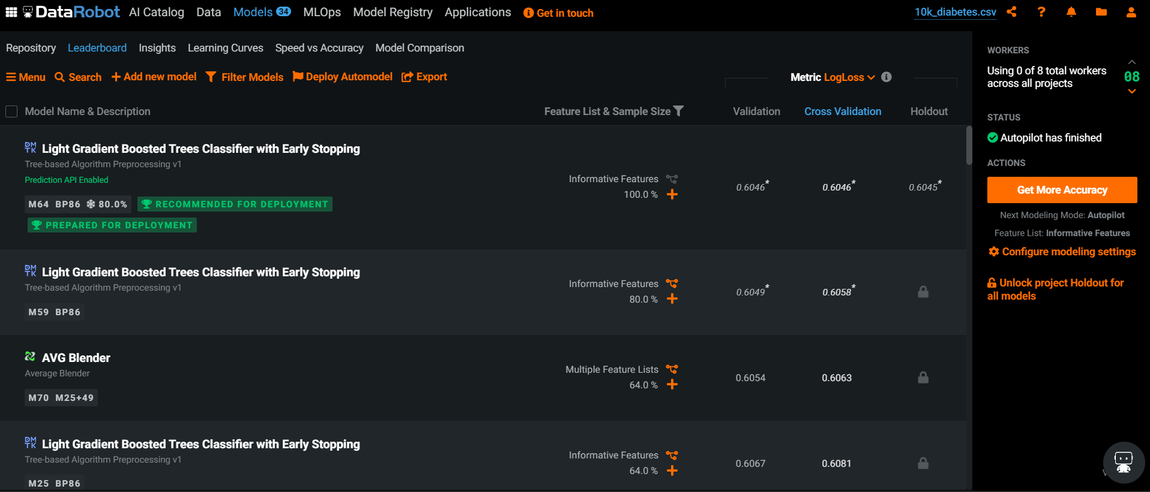
Hospital Readmission – DataRobot Model Training – Leadership Board

Slide 40
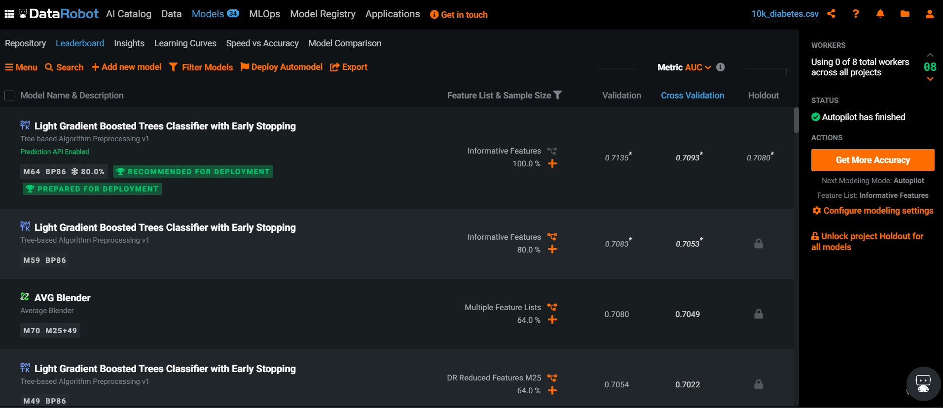
Hospital Readmission – DataRobot Model Training – Leadership Board

Slide 41
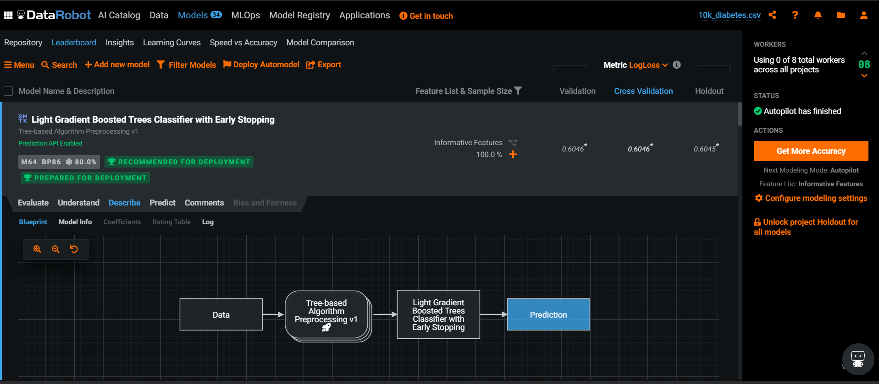
Hospital Readmission – DataRobot Model Training – Leadership Board Style

Slide 42
Hospital Readmission – DataRobot Model Training – Leadership Board Style

Slide 43
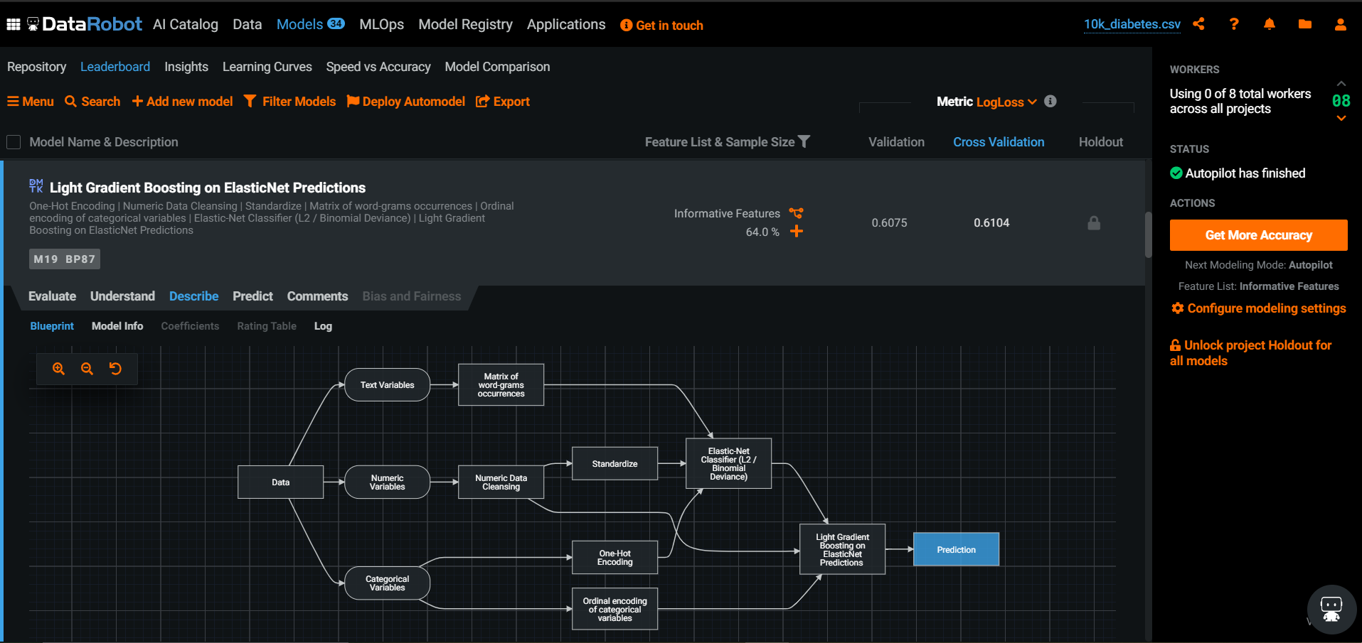
Hospital Readmission – Model Understanding

Slide 44
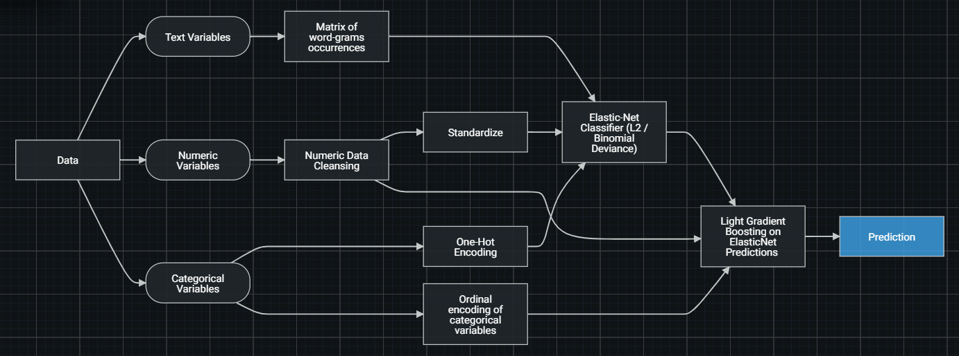
Hospital Readmission – Model Training

Slide 45
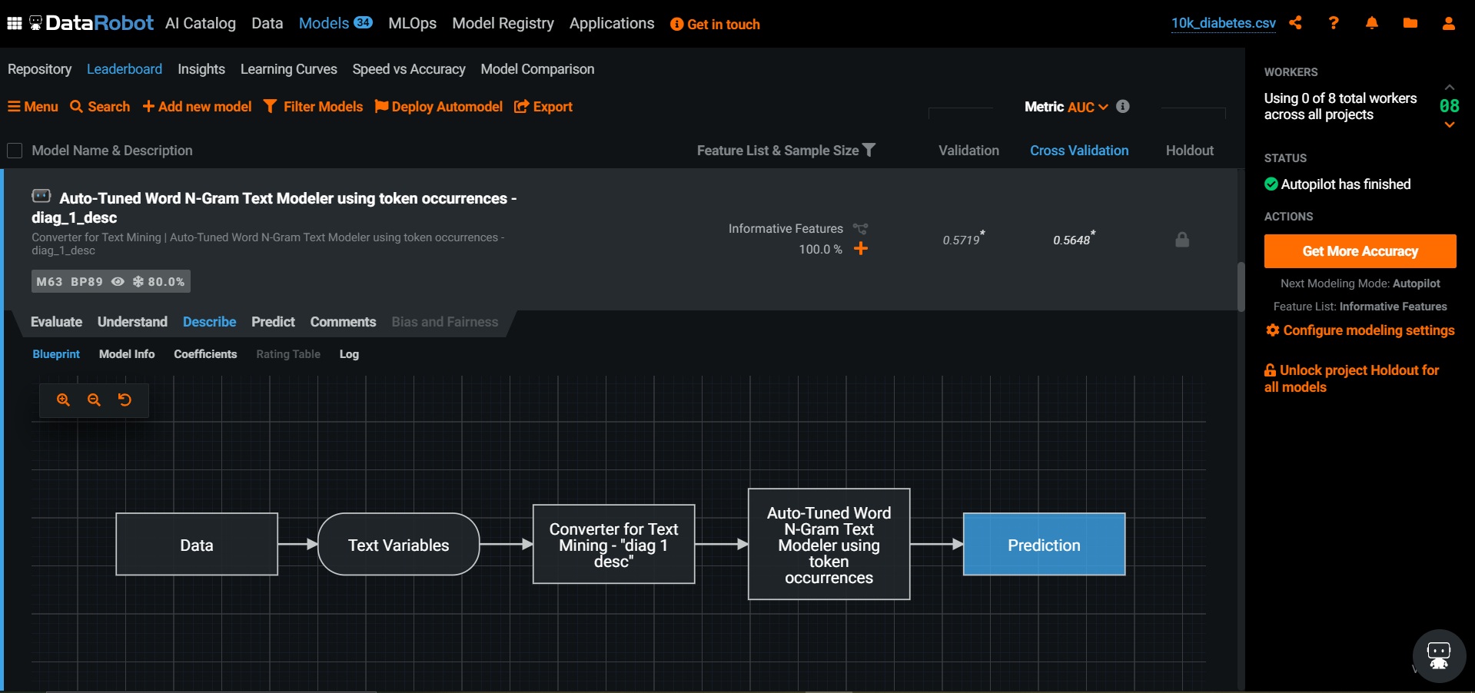
Hospital Readmission – DataRobot Model Training – Describing the Model

Slide 46
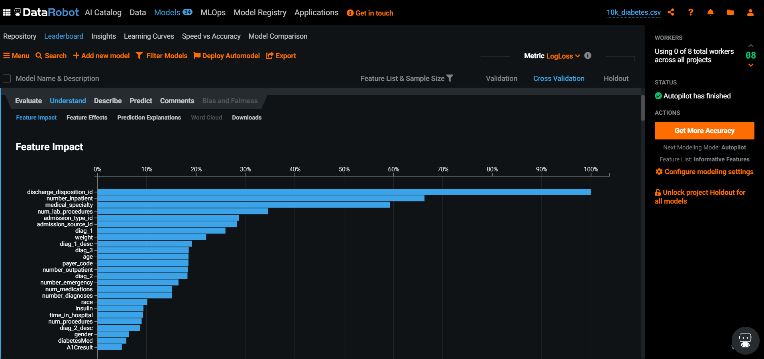
Hospital Readmission – DataRobot Variable Importance

Slide 47
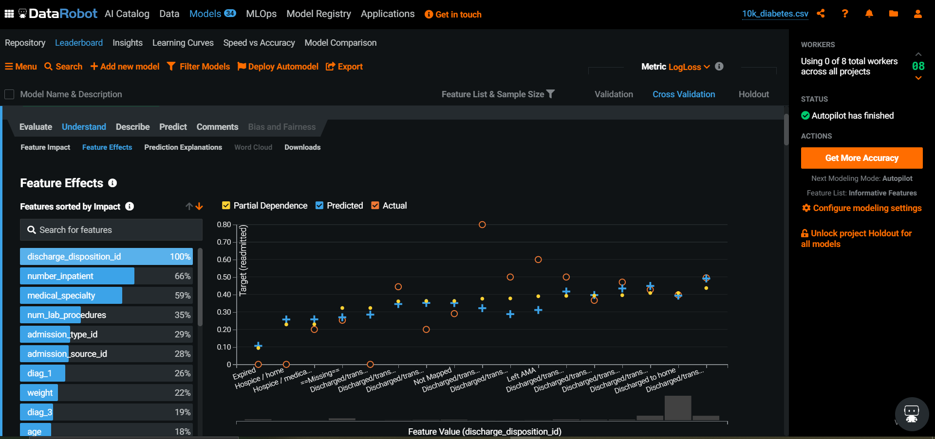
Hospital Readmission – DataRobot Model Training – Understanding the Model

Slide 48
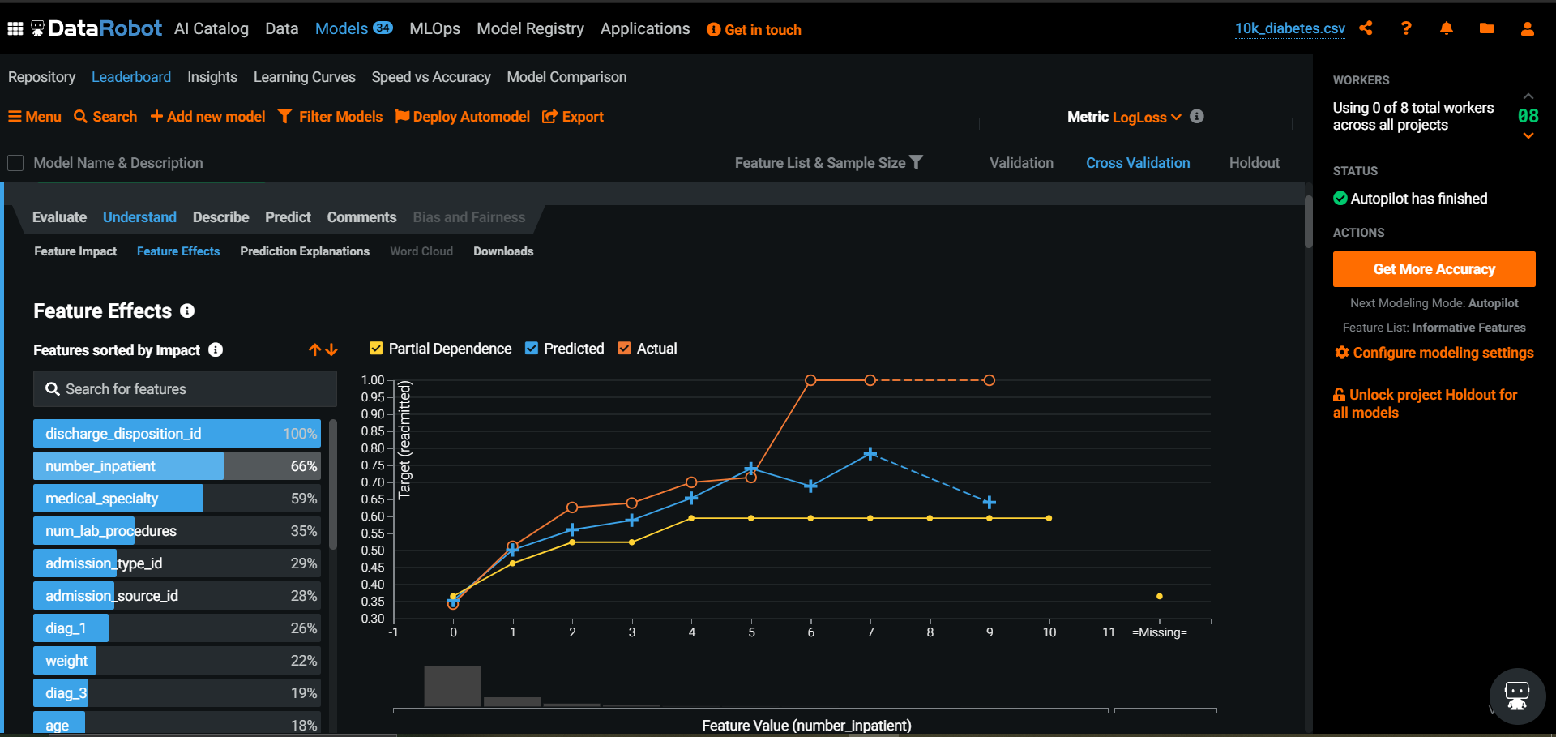
Hospital Readmission – DataRobot Model Training – Understanding the Model

Slide 49
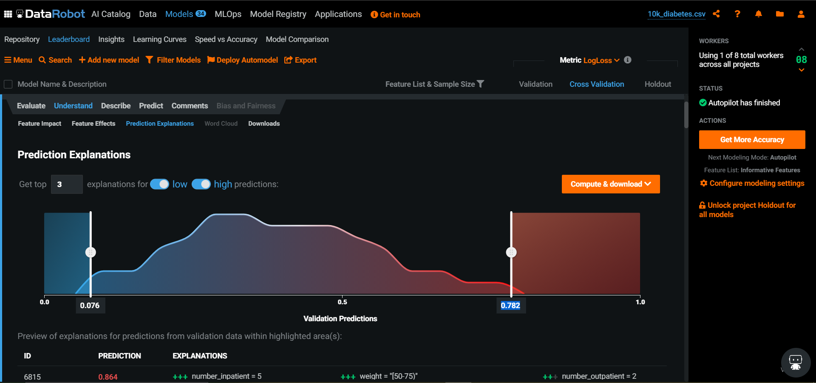
Hospital Readmission – DataRobot Model Training – Model Prediction

Slide 50
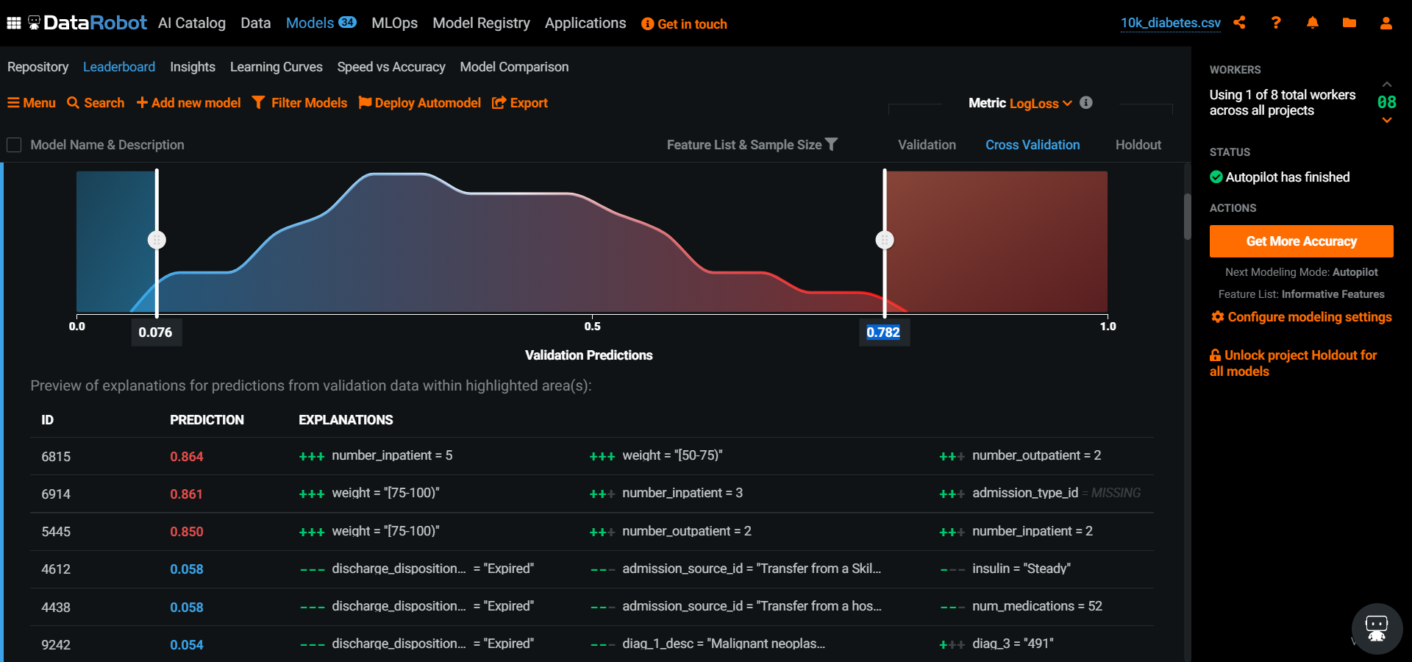
Hospital Readmission – DataRobot Model Training – Model Prediction

Slide 51
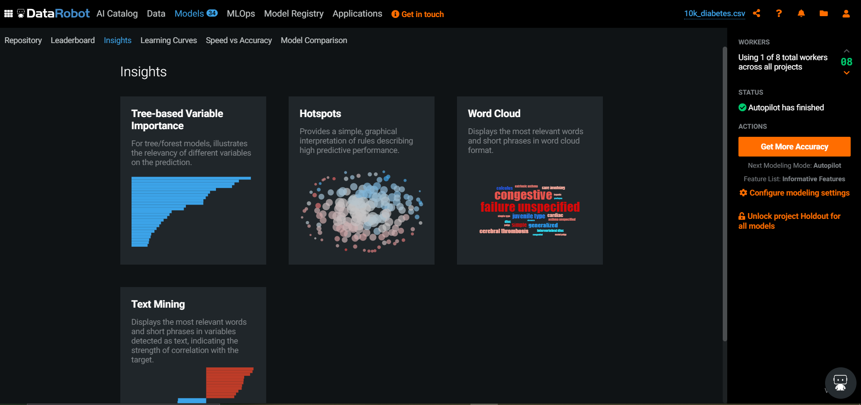
Hospital Readmission – Model Insights

Slide 52
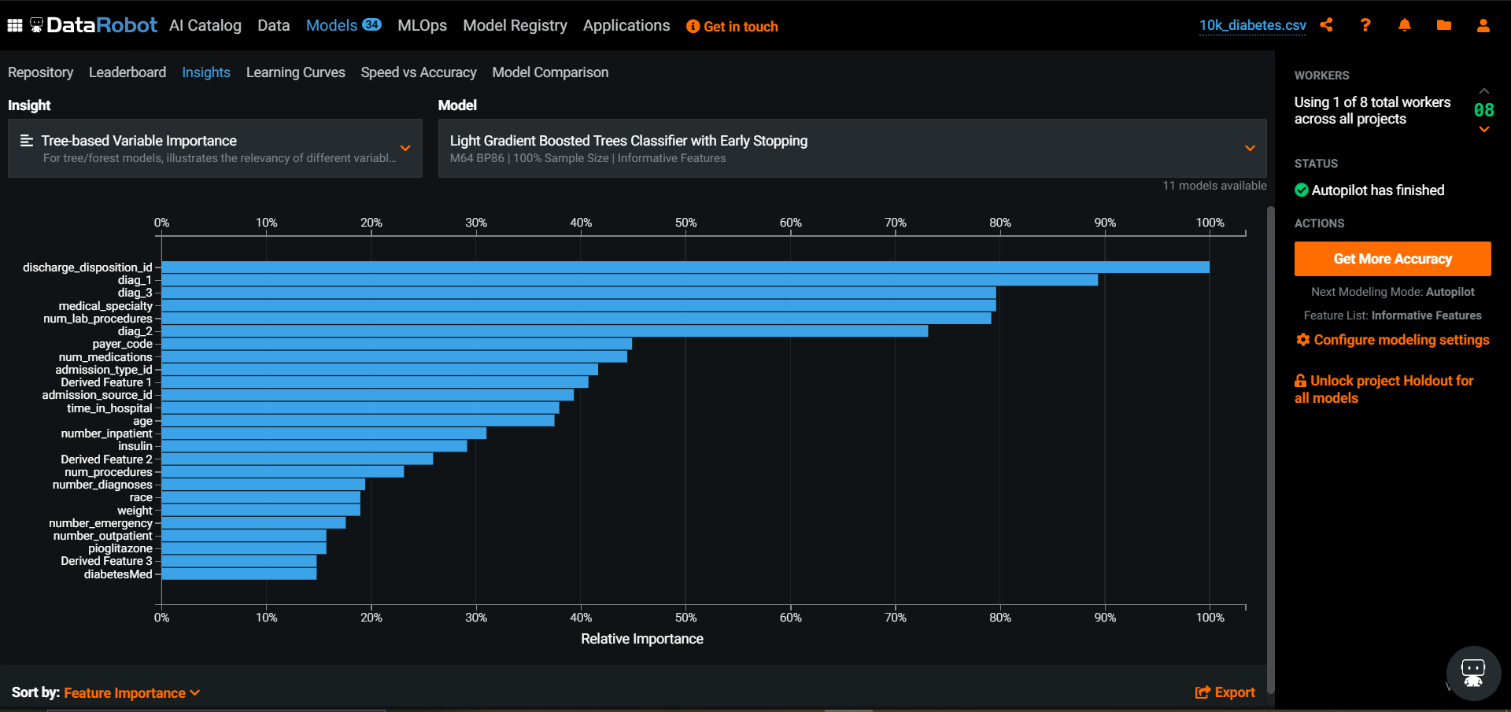
Hospital Readmission – Model Insights

Slide 53
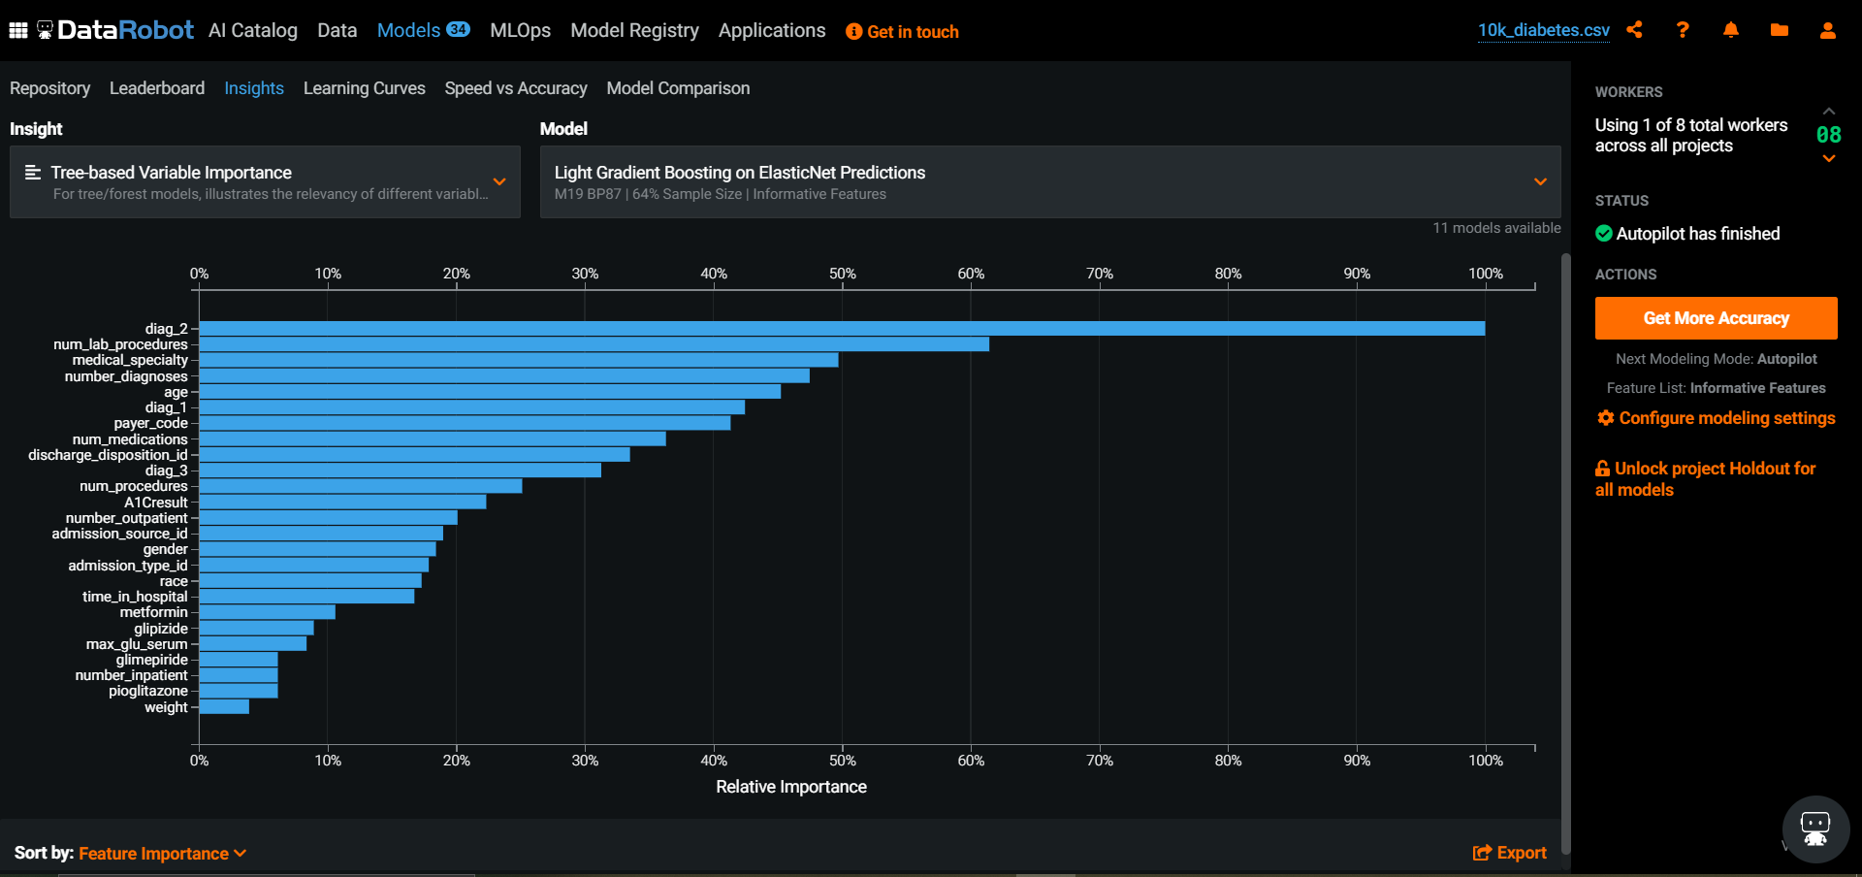
Hospital Readmission – Model Insights

Slide 54
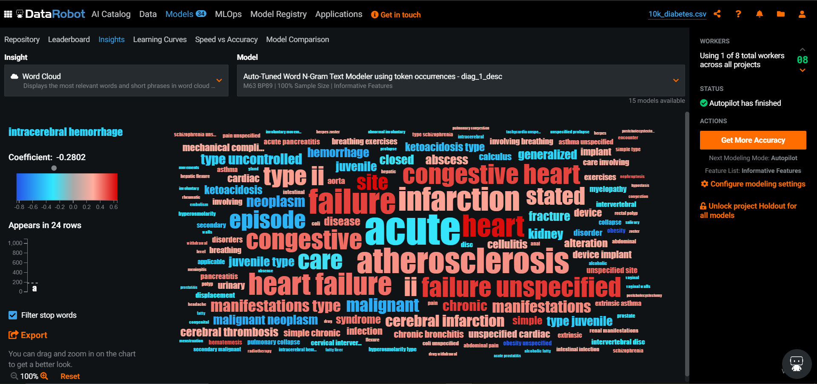
Hospital Readmission – Model Insights

Slide 55
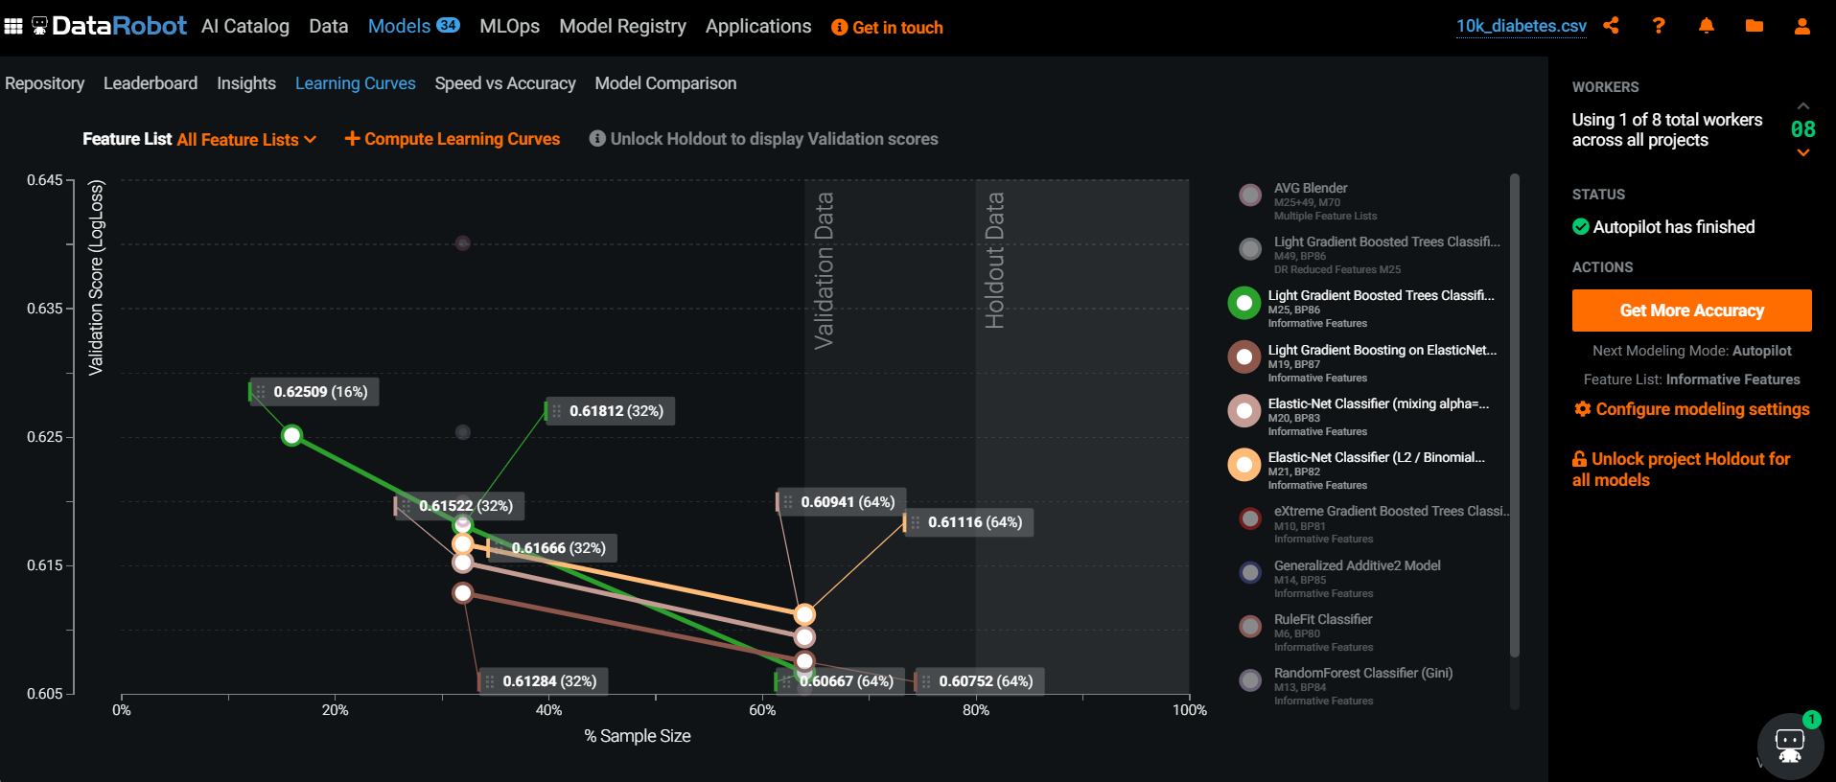
Hospital Readmission – Model Learning
Model

Slide 56
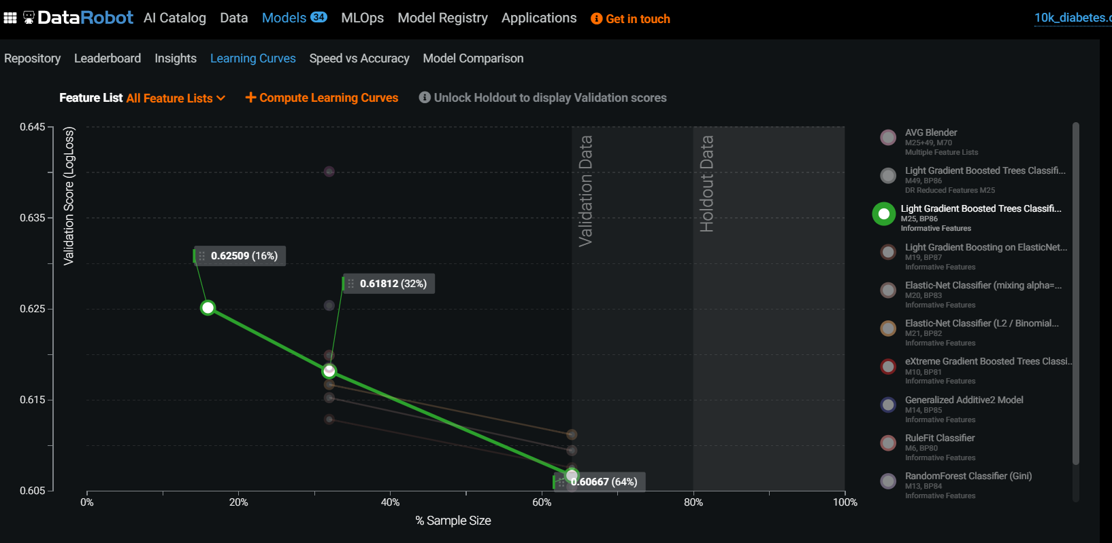
Hospital Readmission – Model Learning
Model

Slide 57
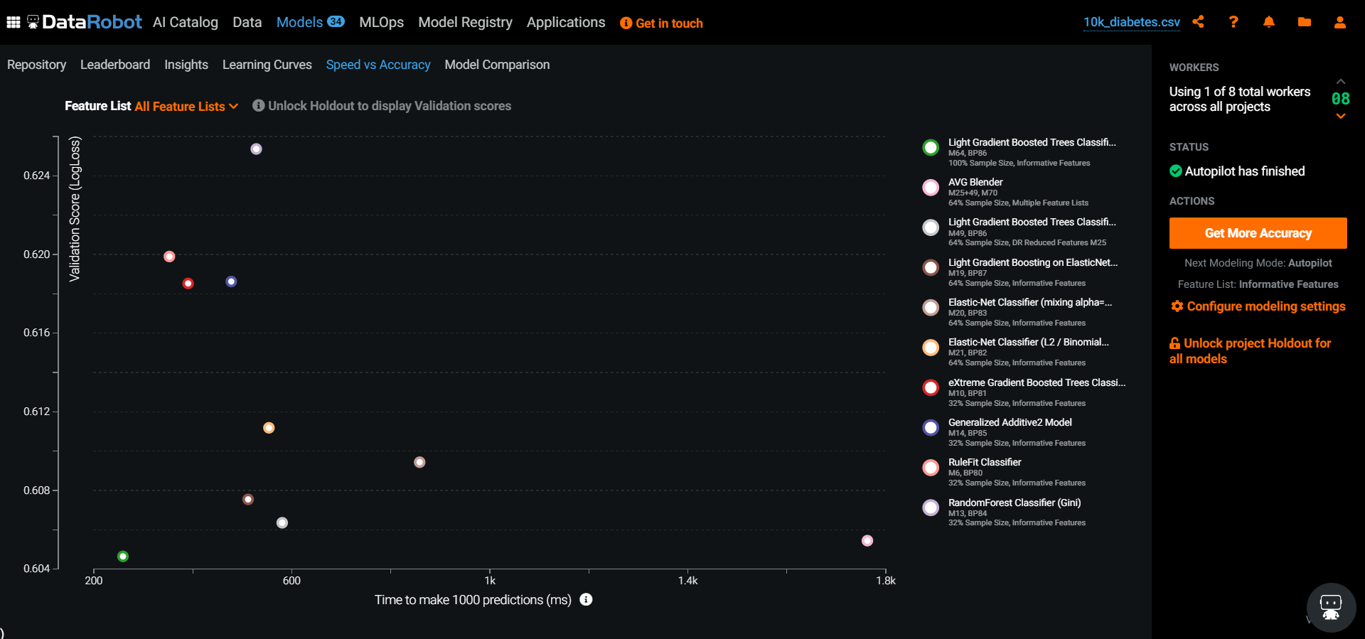
Hospital Readmission – Model Comparisons
Model

Slide 58
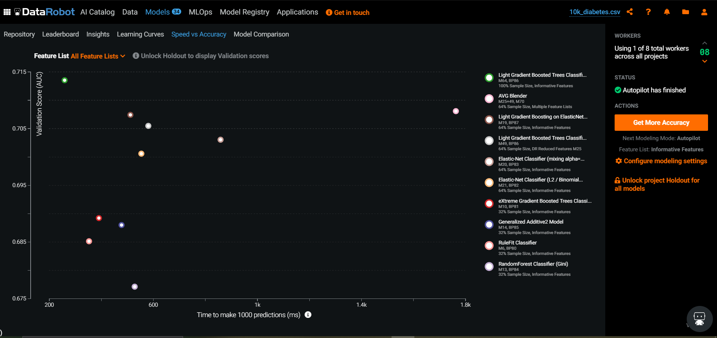
Hospital Readmission – Model Comparisons
Model

Slide 59
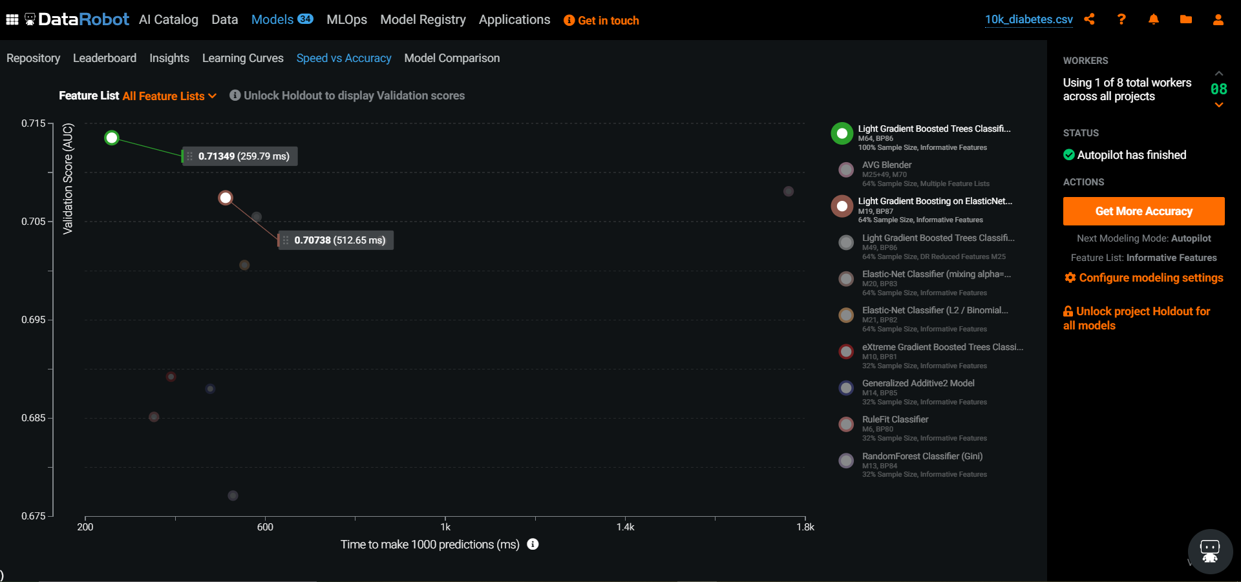
Hospital Readmission – Model Comparisons
Model

Slide 60
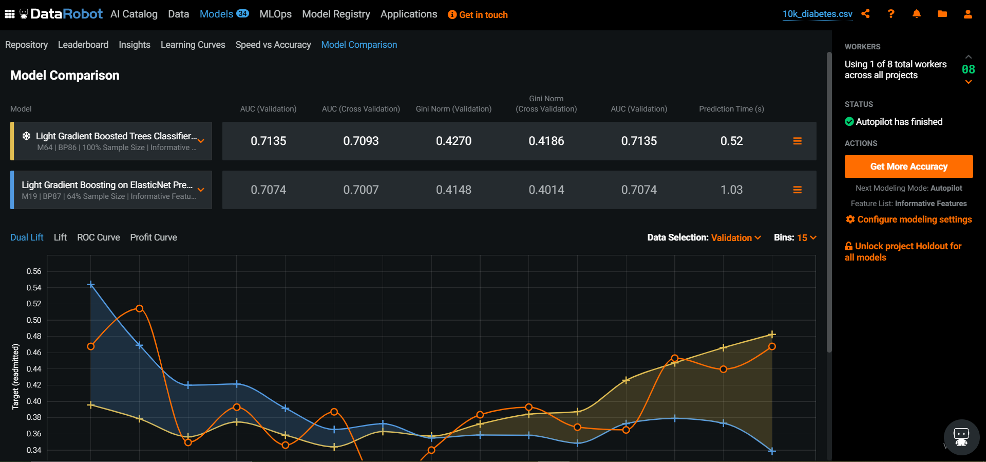
Hospital Readmission – Model Comparisons
Model

Slide 61
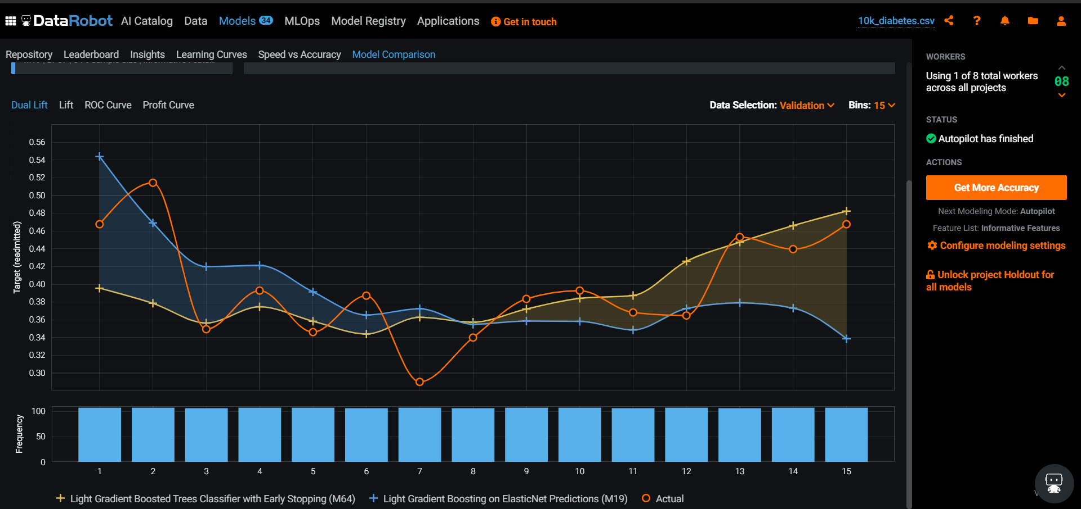
Hospital Readmission – Model Comparisons
Model

Slide 62
Hospital Readmission – Model Comparisons
Model

Slide 63
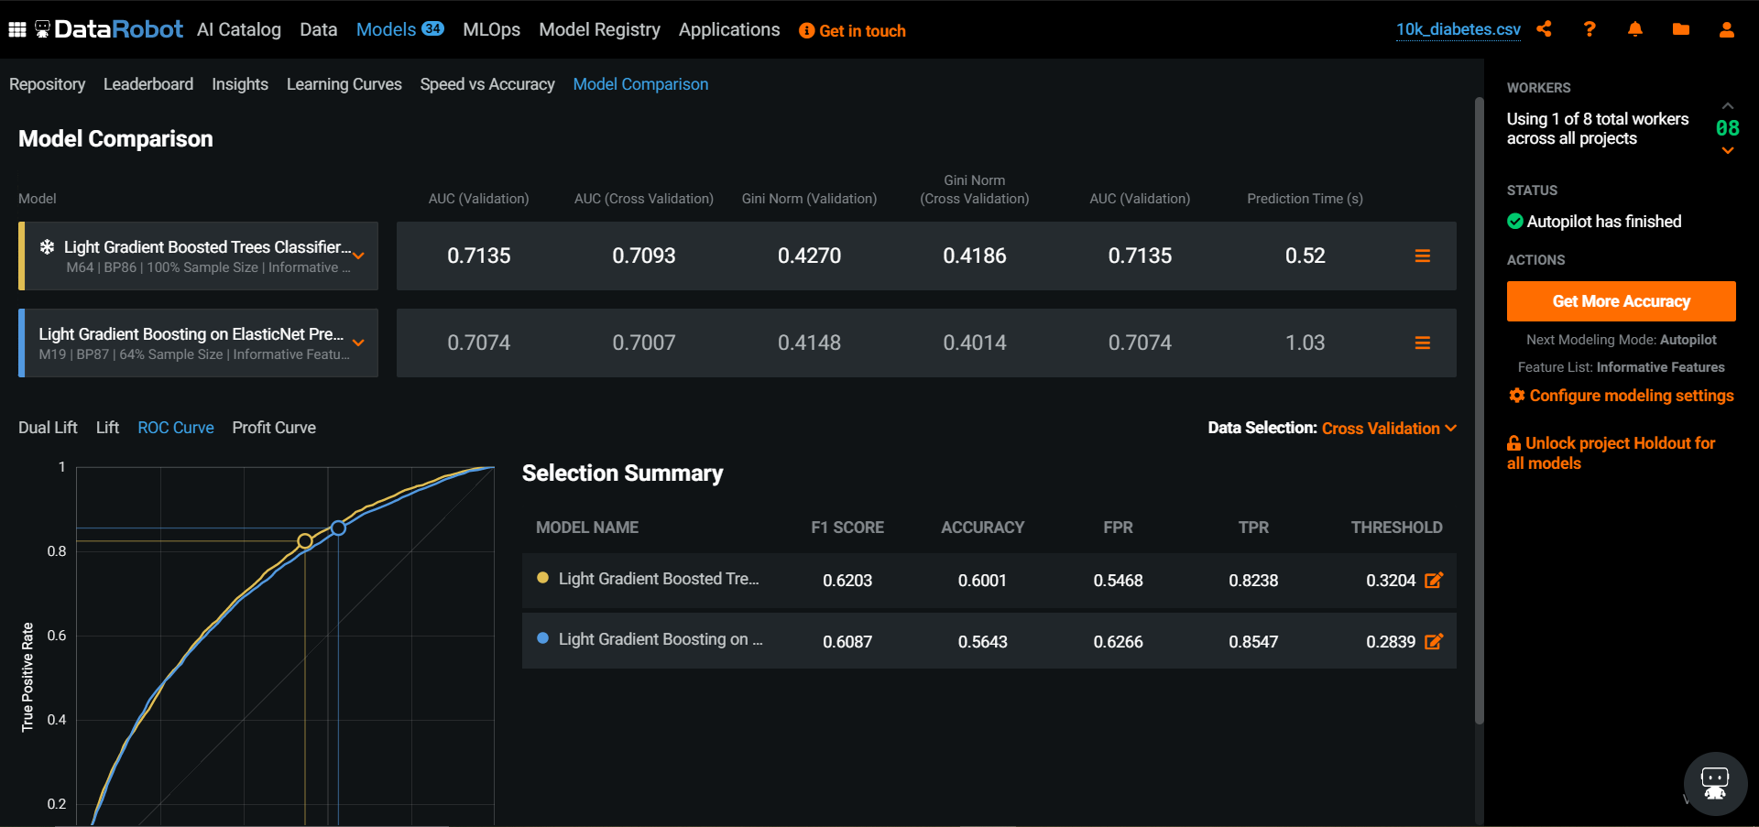
Hospital Readmission – Model Comparisons
Model

Slide 64
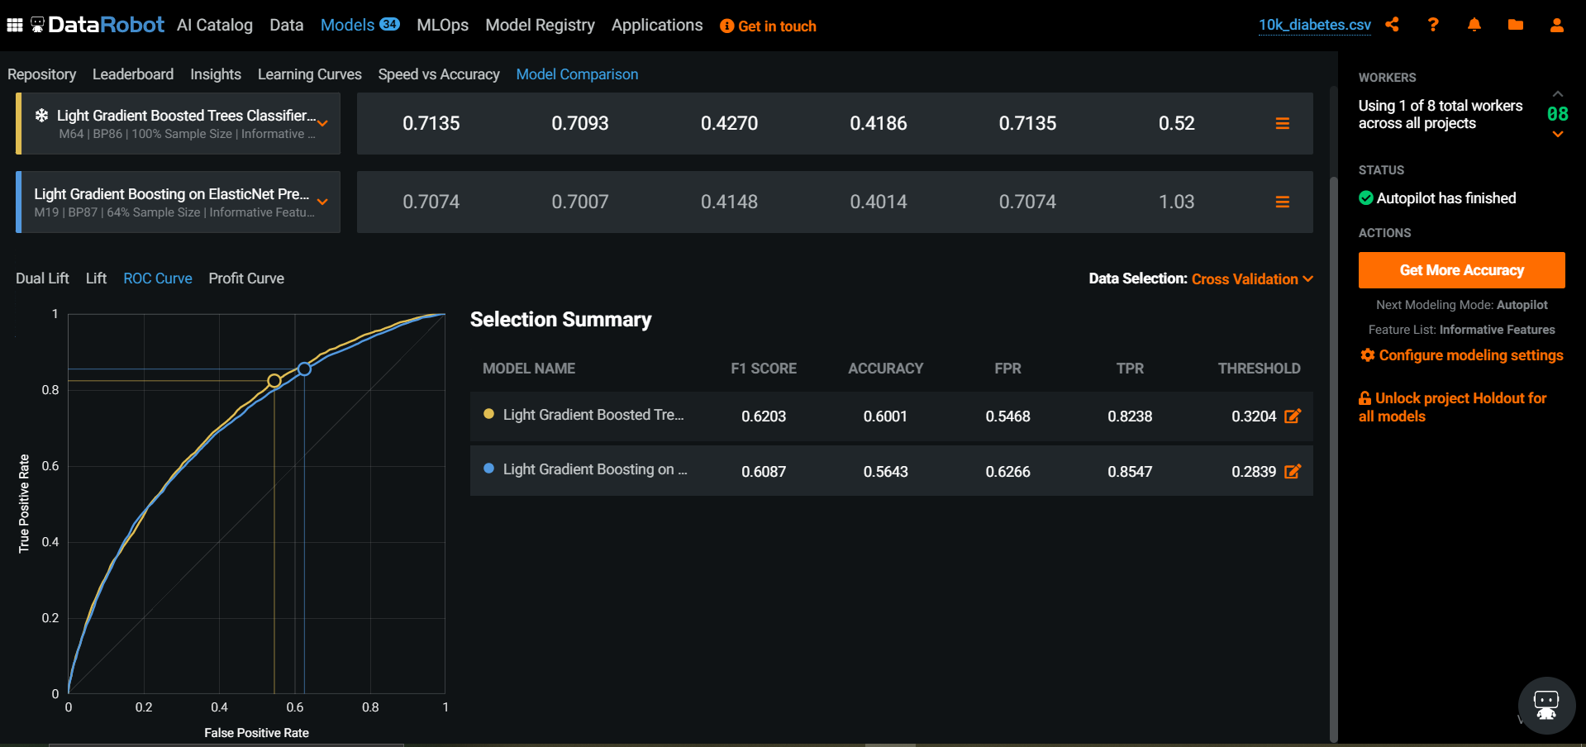
Hospital Readmission – Model Comparisons
Model

Slide 65
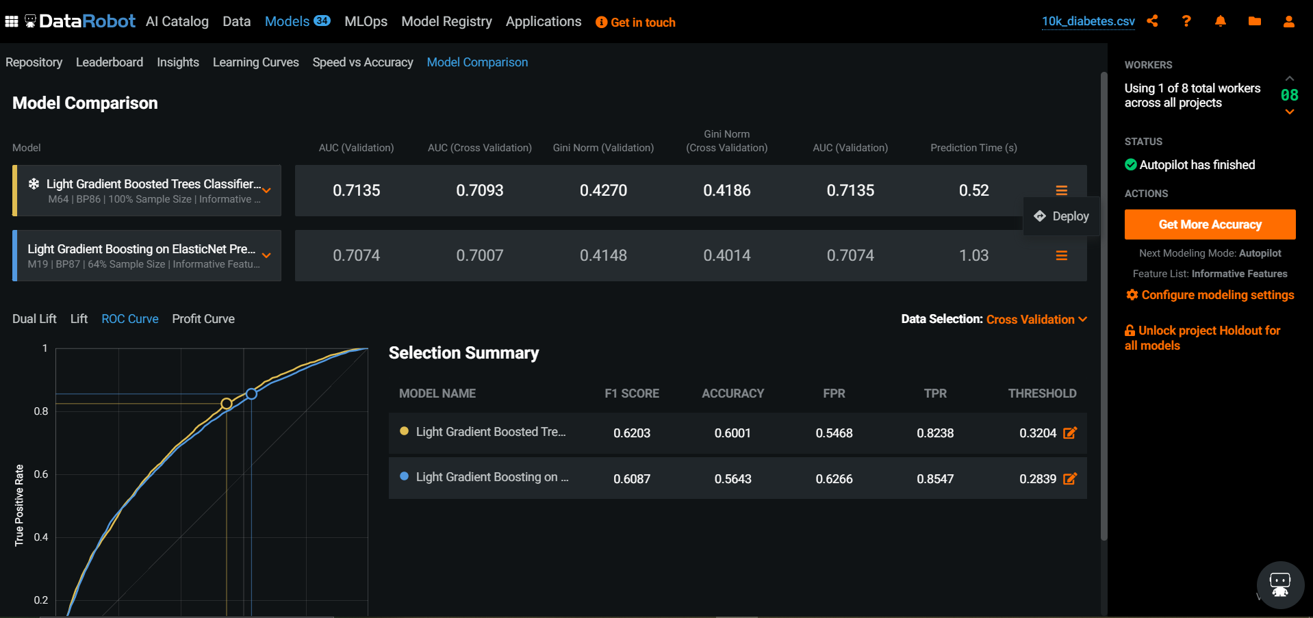
Hospital Readmission – Model Comparisons
Model

Slide 66
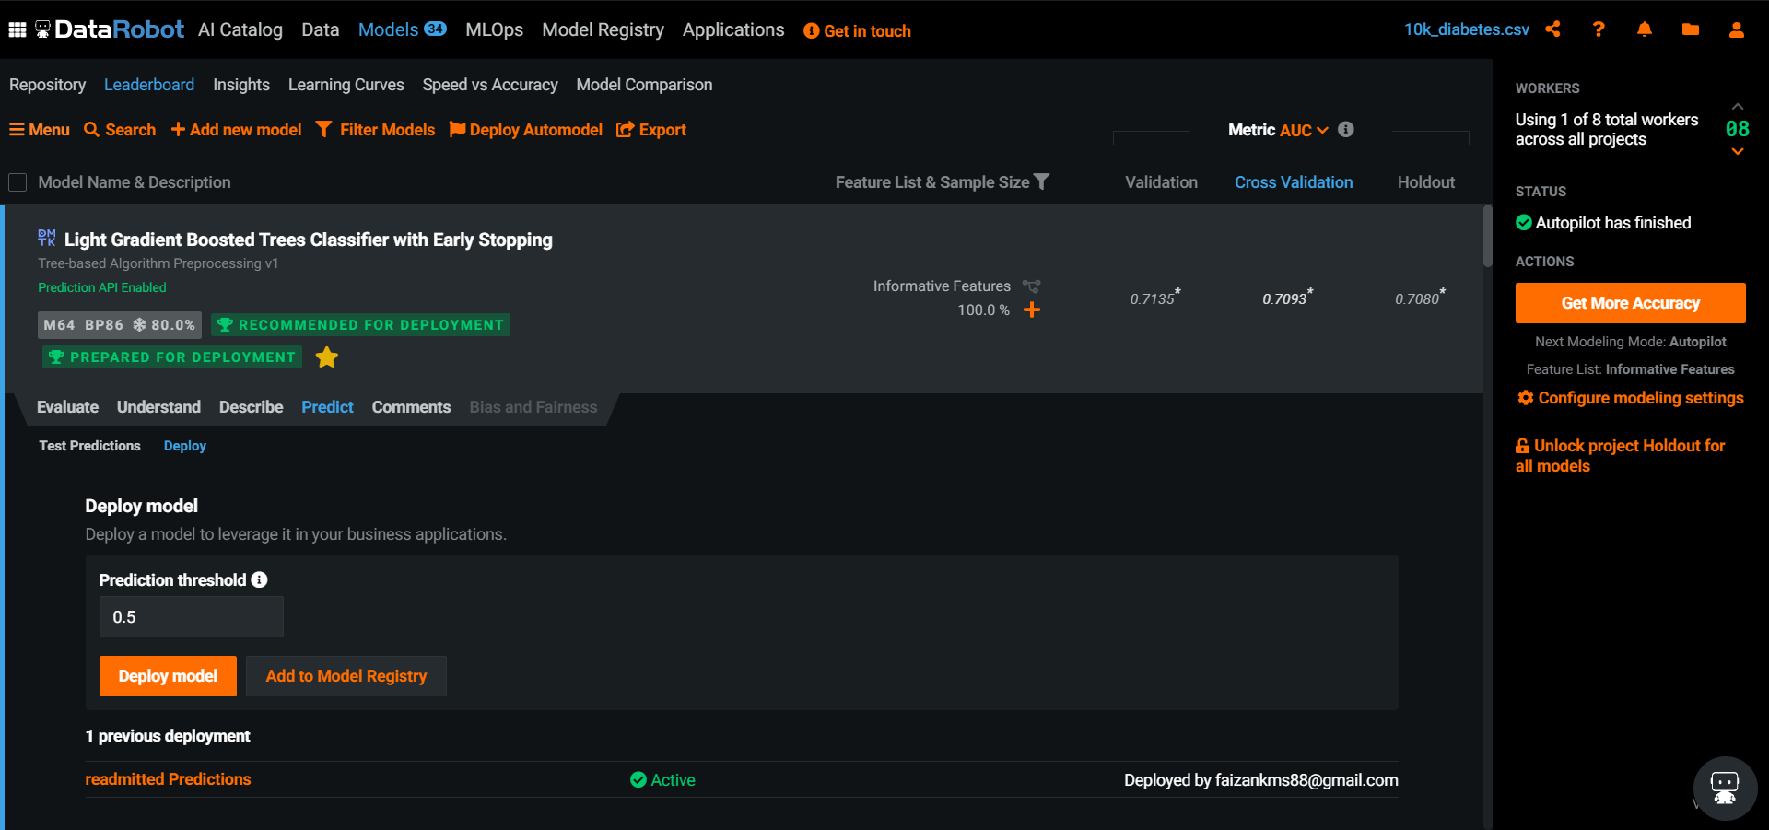
Hospital Readmission – Model Prediction
Model

Slide 67
Hospital Readmission – Model Deployment

Slide 68
Hospital Readmission – Model Deployment
Model

Slide 69
Hospital Readmission – Model Deployment
Model

Slide 70
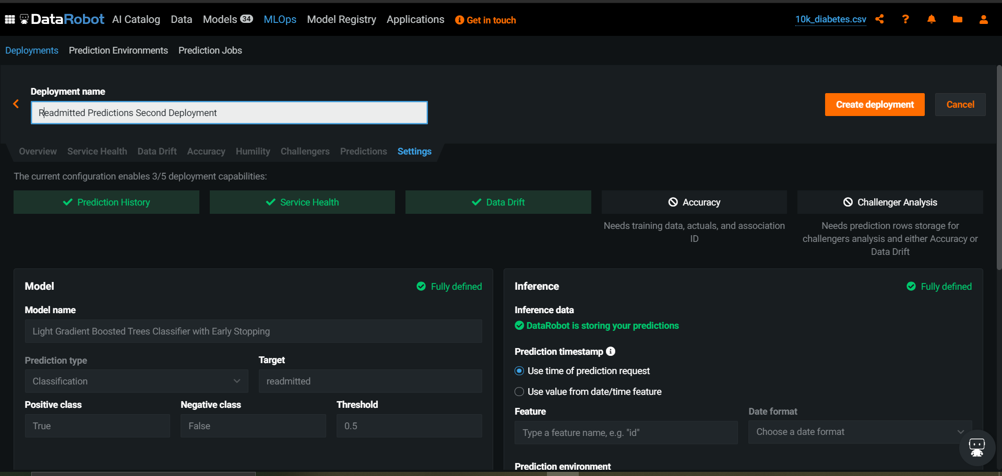
Hospital Readmission – Model Deployment

Slide 71
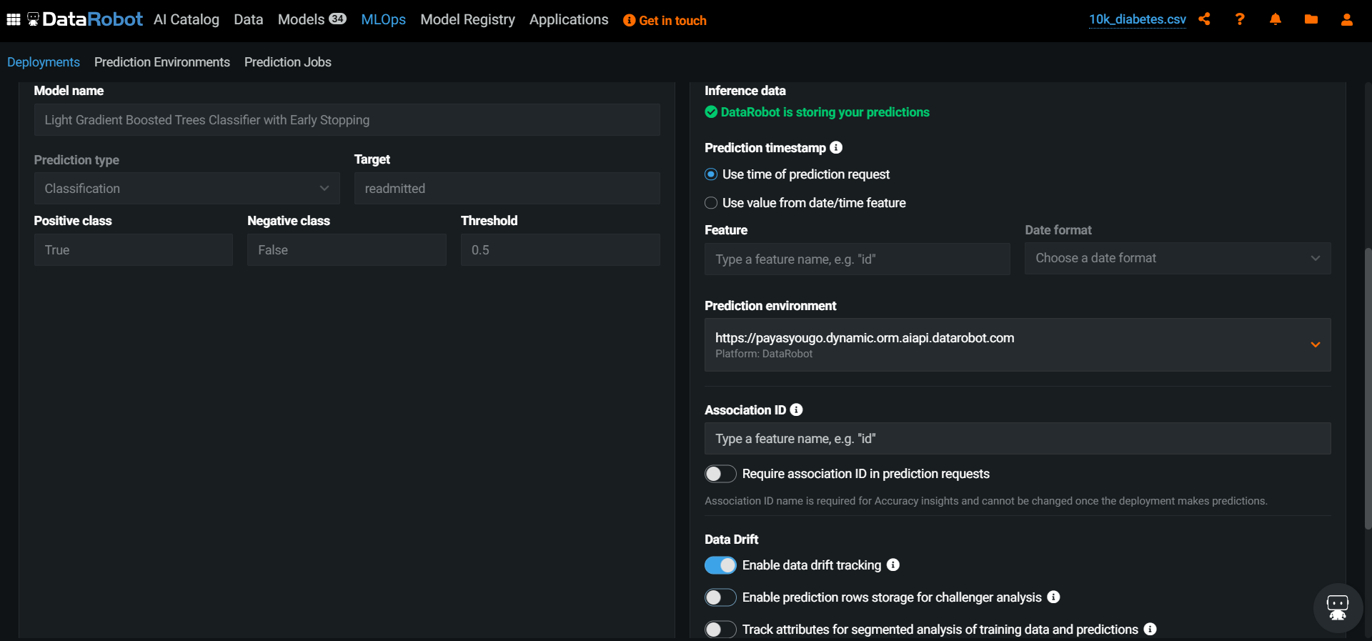
Hospital Readmission – Model Deployment

Slide 72
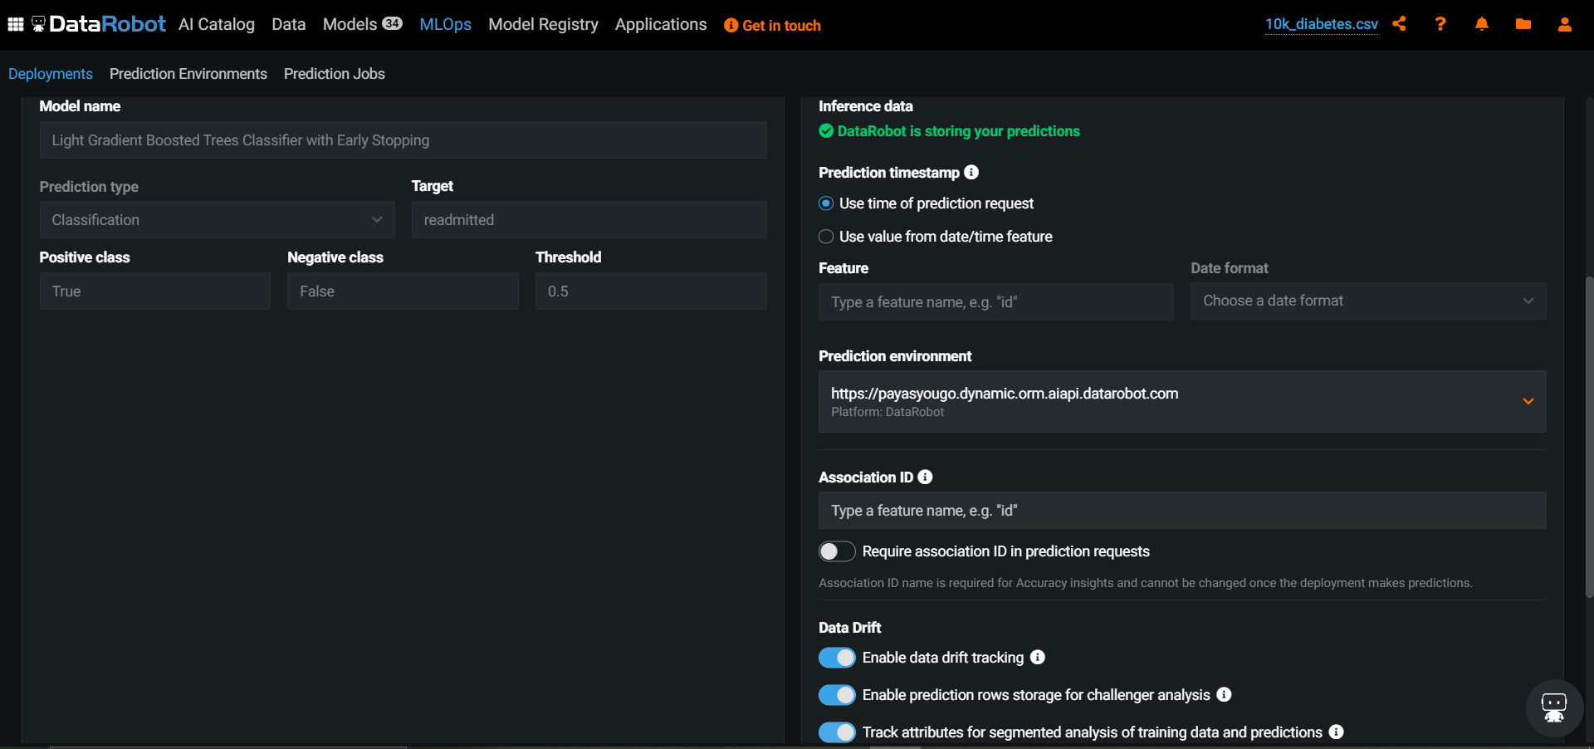
Hospital Readmission – Model Deployment

Slide 73
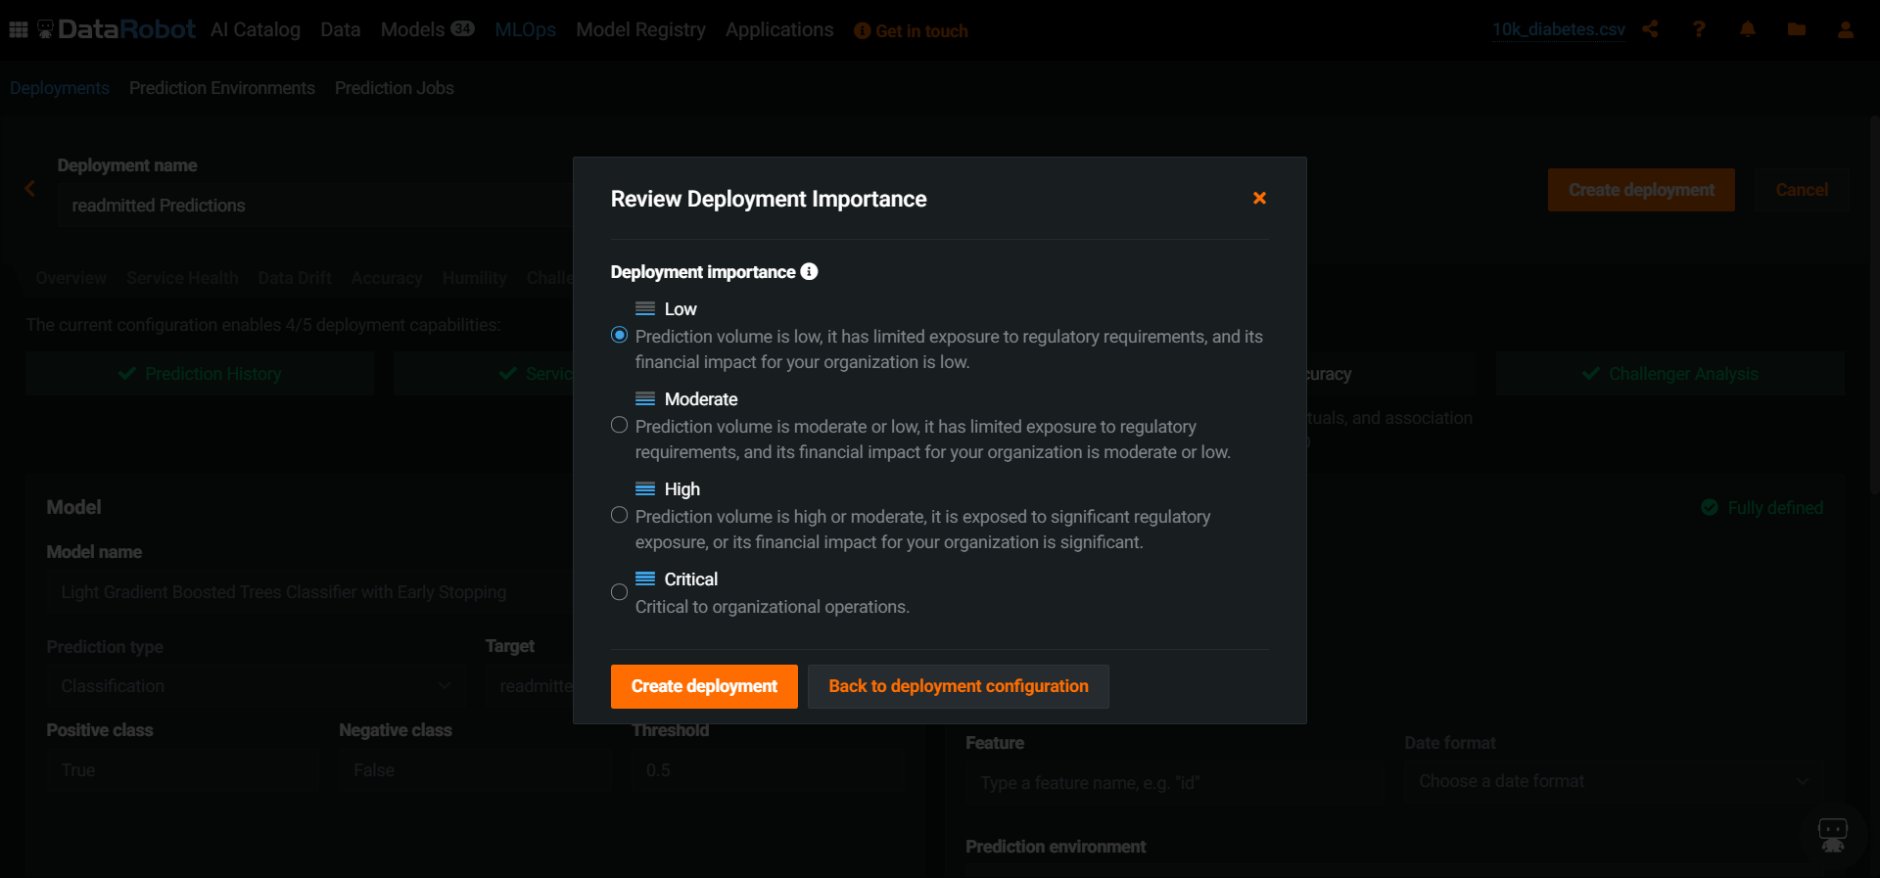
Hospital Readmission – Model Deployment

Slide 74
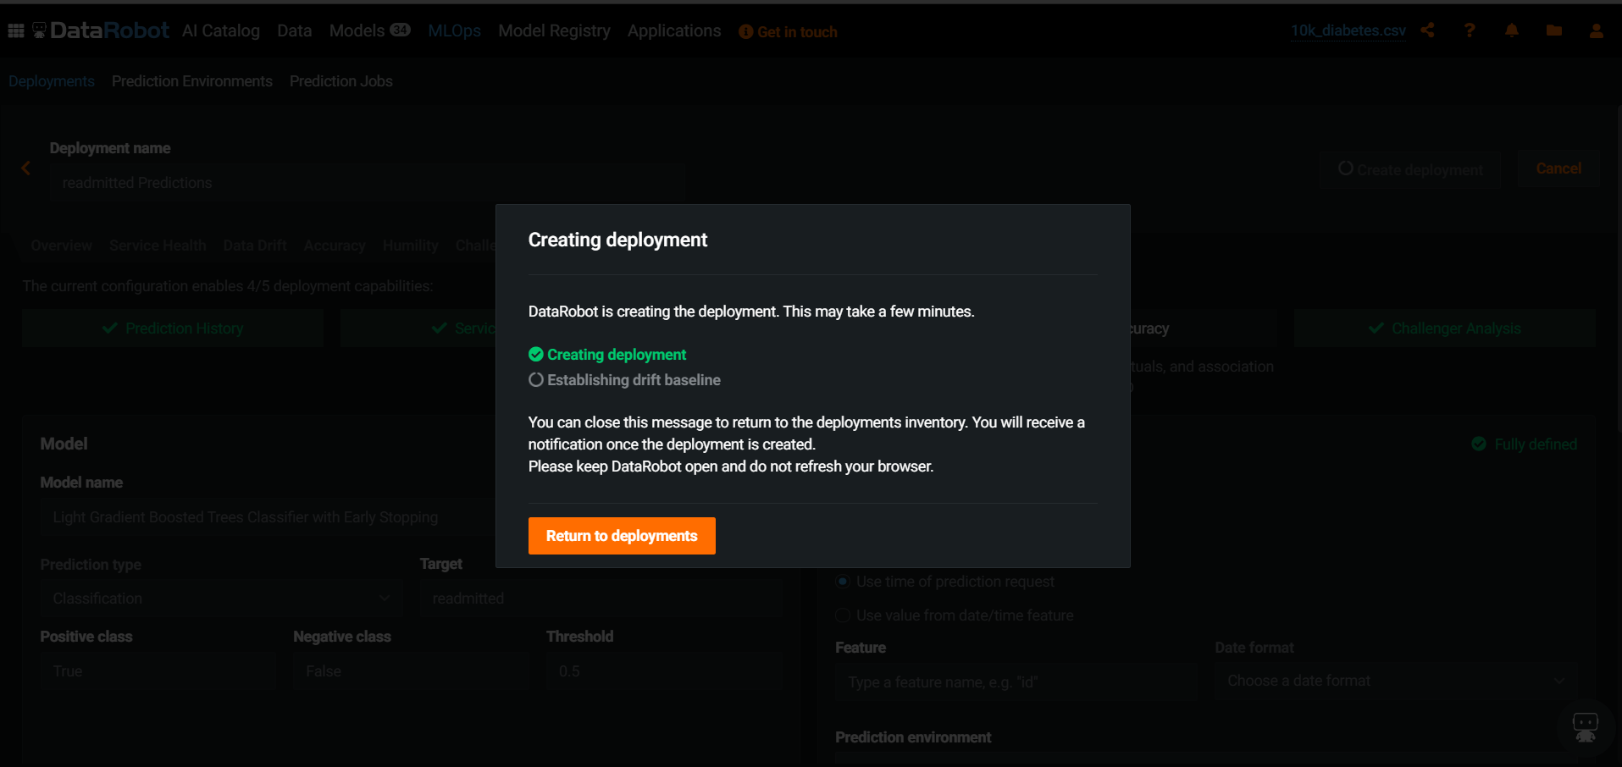
Hospital Readmission – Model Deployment

Slide 75
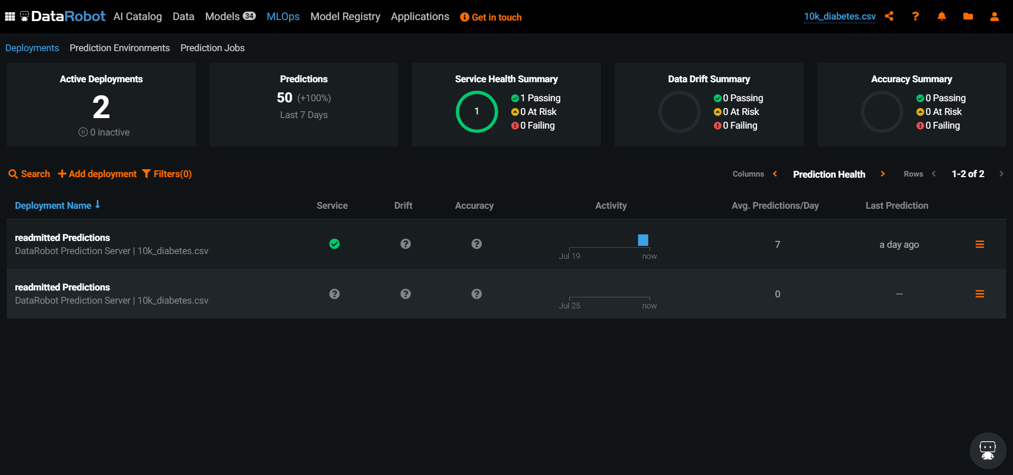
Hospital Readmission – Deployed Model

Slide 76

Hospital Readmission – Deployed Model

Slide 77

Hospital Readmission – Deployed Model

Slide 78

Hospital Readmission – Deployed Model

Slide 79

Hospital Readmission – Deployed Model

Slide 80

Hospital Readmission – Deployed Model

Slide 81

Hospital Readmission – Deployed Model

Slide 82

Hospital Readmission – Deployed Model

Slide 83

Hospital Readmission – Deployed Model

Slide 84

Hospital Readmission – Deployed Model

Slide 85

Hospital Readmission – Deployed Model

Slide 86
End of Back up Slides in case of connection failure for the Live Demo.

Slide 87
Hospital Readmission – Deployed Model
DataRobot + Tableau Dashboard

Slide 88

Hospital Readmission – Tableau Dashboard

Slide 89
Hospital Readmission – Tableau Dashboard

Slide 90
Hospital Readmission – Tableau Dashboard

Slide 91

Hospital Readmission – Tableau Dashboard

Slide 92

Hospital Readmission – Tableau Dashboard

Slide 93

Hospital Readmission – API’S

Slide 94
Summary
Amazing Value in record time.
The future interface of model training, deployment, and production maintenance.
Built for business people and data scientists.
Summary Video: https://www.youtube.com/watch?v=_JOKlSwKJ10&ab_channel=DataRobot

Slide 95
Summary
Amazing Value in record time.
The future interface of model training, deployment, and production maintenance.
Built for business people and data scientists.
Summary Video: https://www.youtube.com/watch?v=_JOKlSwKJ10&ab_channel=DataRobot

Slide 96
References
https://www.datarobot.com/success/
https://news.crunchbase.com/news/enterprise-ai-platform-datarobot-lands-270m-at-2-7b-valuation/
https://growjo.com/company/DataRobot
https://www.crunchbase.com/organization/datarobot/company_financials
https://www.axios.com/datarobot-raises-250-million-enterprise-ai-e376116d-ecf3-4dd8-b3ac-21692070a778.html
https://www.youtube.com/watch?v=KdYrUzCPR-M&ab_channel=TableauSoftware

Slide 97
Questions?
Faizan Khalid Mohsin
M.Sc. Biostatistics & AI Applications
University of Toronto
LinkedIn: https://www.linkedin.com/in/faizan-khalid-mohsin/
GitHub: https://github.com/FaizanKhalidMohsin

Slide 98
Hospital Readmissions
DataRobot Demo
Faizan Khalid Mohsin
M.Sc Biostatistics & AI Applications
University of Toronto

Slide 99
What Does DataRobot do?
A Glimpse into the DataRobot Machine Learning Automation Platform
https://www.youtube.com/watch?v=_JOKlSwKJ10&ab_channel=DataRobot
DataRobot Introduction
https://www.youtube.com/watch?v=L3V_UJugtJ0&t=4s&ab_channel=MaxIoli

Slide 100
Hospital Readmission – Definitions

Slide 101
Hospital Readmission – DataRobot AutoML Capabilities - Demo
Model Building – Today’s Live Demo

Slide 102
Hospital Readmission – DataRobot Demo

Slide 103
Additional Resources to Explore EDA
Guided Tours: https://www.datarobot.com/tours/

Slide 104





Slide 105
Further fields to explore and potential to get into:
Law

Slide 106

Questions
Further fields to explore and potential to get into:
Law

Slide 107

Questions
Further fields to explore and potential to get into:
Law

Slide 108

Hospital Readmission – DataRobot Demo Data Ingestion

Slide 109

Hospital Readmission – DataRobot Demo Data Ingestion

Slide 110

DataRobot Experience

Slide 111

Hospital Readmission – DataRobot AutoML Capabilities
Model Deployment
Model Building Today’s Demo
Model Deployment

Slide 112
Hospital Readmission – DataRobot AutoML Capabilities - Demo
Data Preparation
Model Building – Today’s Demo
Model Deployment

Slide 113
Hospital Readmissions Use Case
DataRobot Demo
Faizan Khalid Mohsin
M.Sc. Biostatistics & AI Applications
University of Toronto

